Slide 1
Space Weather impacts on satellites at different orbits
Outline
Prelude
Orbits
Different types of SWx effects on satellites
Satellite anomalies from the recent March 2012 SWx events
Yihua Zheng
June 10, 2013
SW REDI
Internal Use Only
Please do not distribute

Slide 2
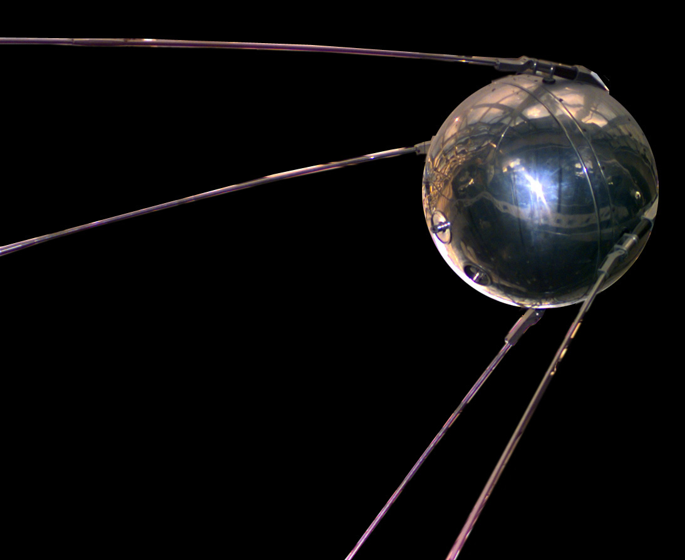
1st satellite launched into space
The world's first artificial satellite, the Sputnik 1, was launched by the Soviet Union in 1957.
marking the start of the Space Age
4 October, 1957
International Geophysical Year: 1957

Slide 3
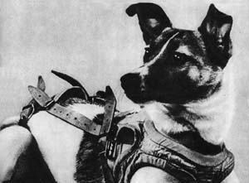
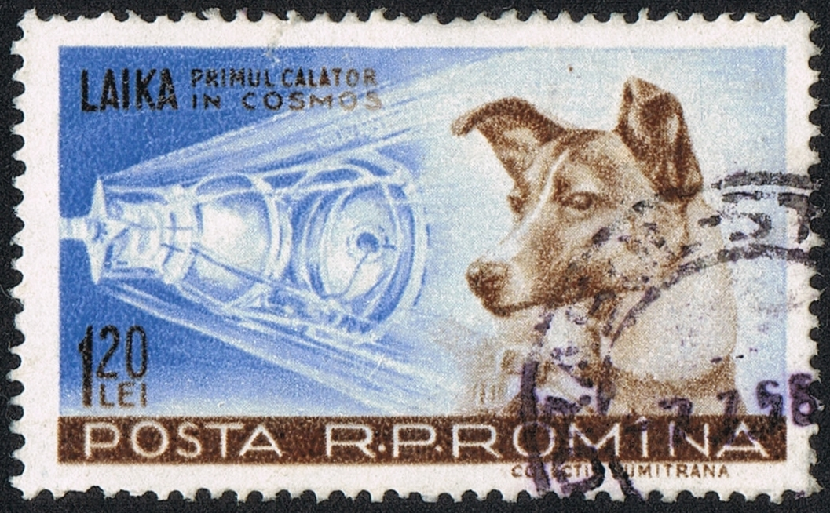
Space dog - Laika
the occupant of the Soviet spacecraft Sputnik 2 that was launched into outer space on November 3, 1957
Paving the way for human missions

Slide 4
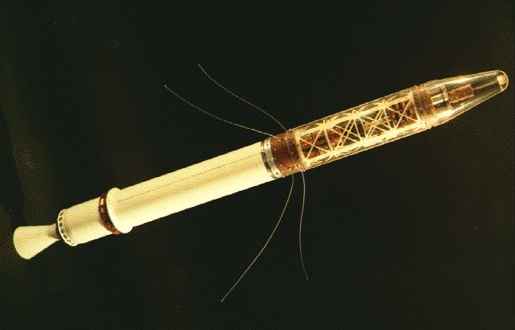
Explorer I – 1st U.S. Satellite
Explorer 1, was launched into Earth's orbit on a Jupiter C missile from Cape Canaveral, Florida, on January 31, 1958 - Inner belt

Slide 5
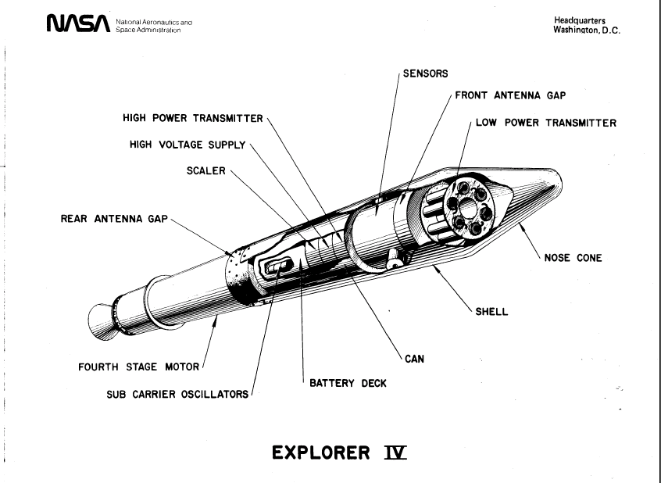
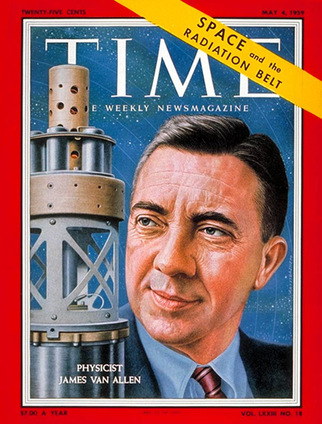
Discovery of the outer Van Allen RB
Pioneer 3 (launched 6 December 1958) and Explorer IV (launched July 26, 1958) both carried instruments designed and built by Dr. Van Allen. These spacecraft provided Van Allen additional data that led to discovery of a second radiation belt

Slide 6
Van Allen Probes – more than half-century later

Slide 7
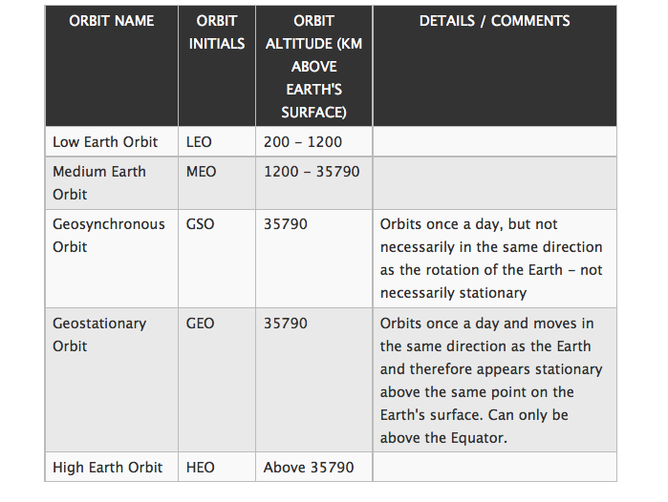
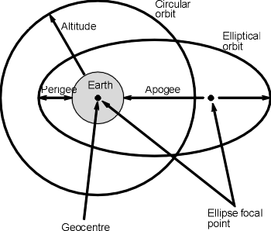
Orbits

Slide 8
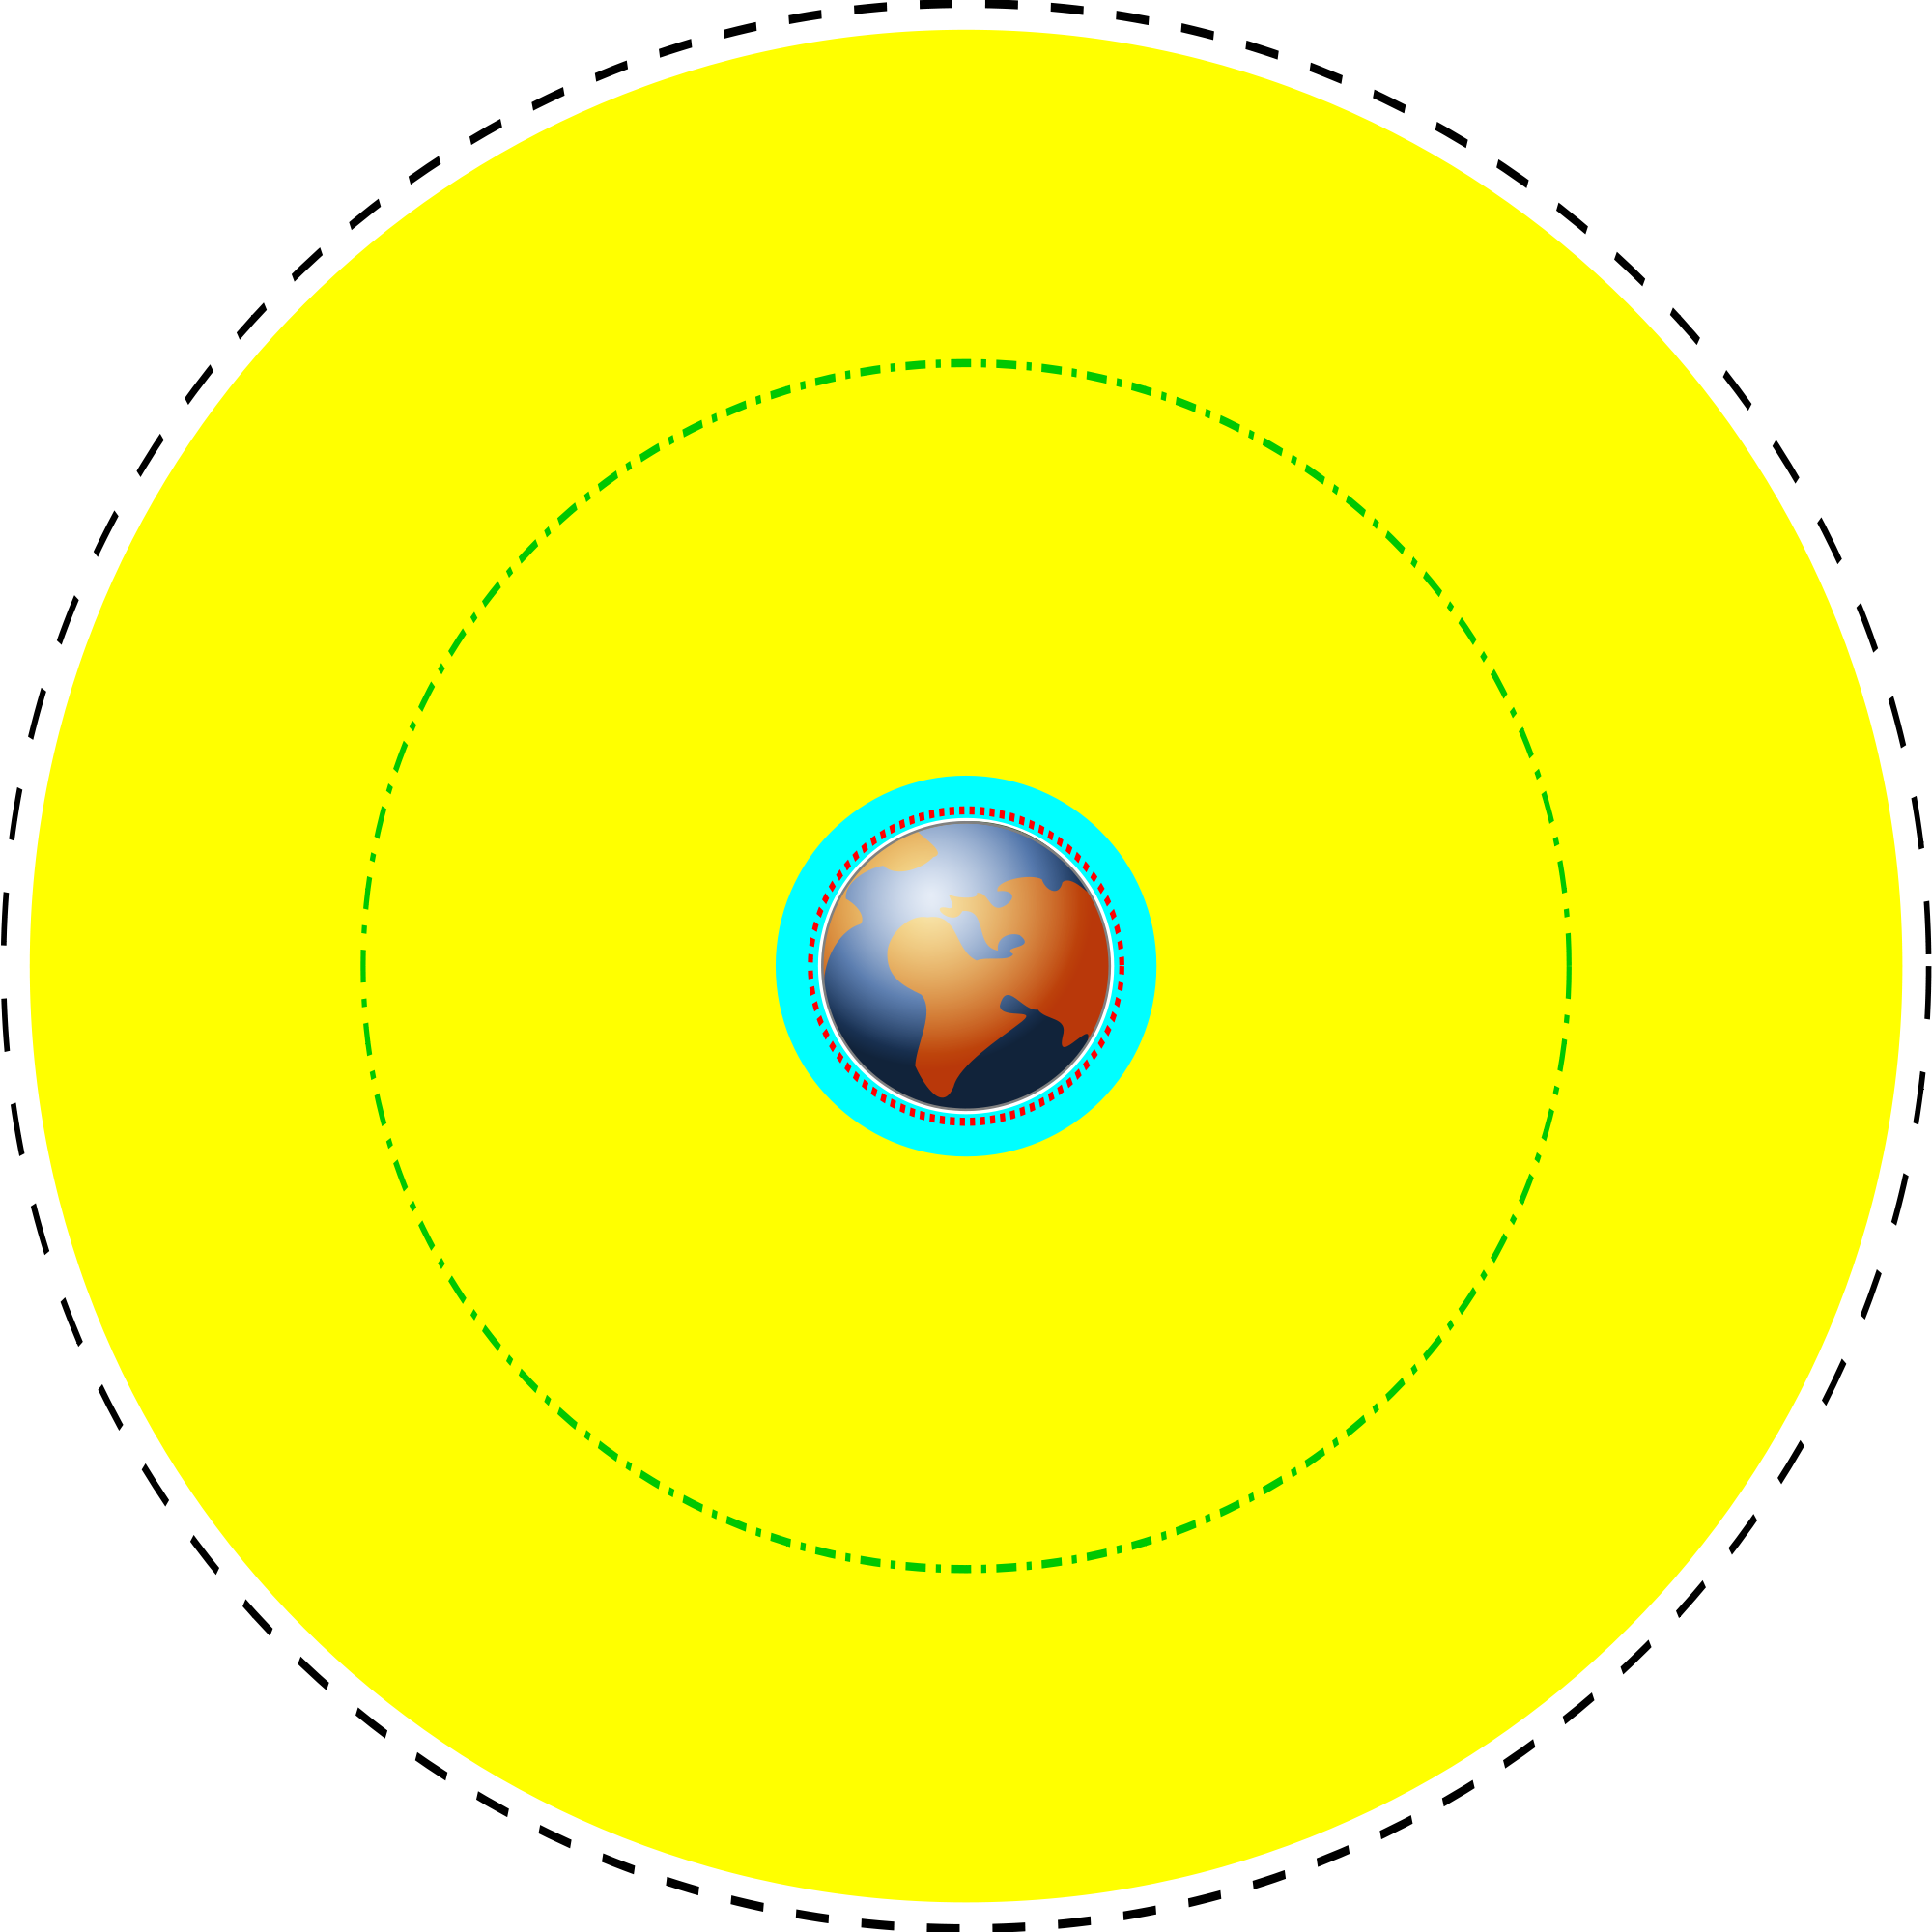
orbits
GEO
Yellow: MEO
Green-dash-dotted line: GPS
Cyan: LEO
Red dotted line: ISS

Slide 9
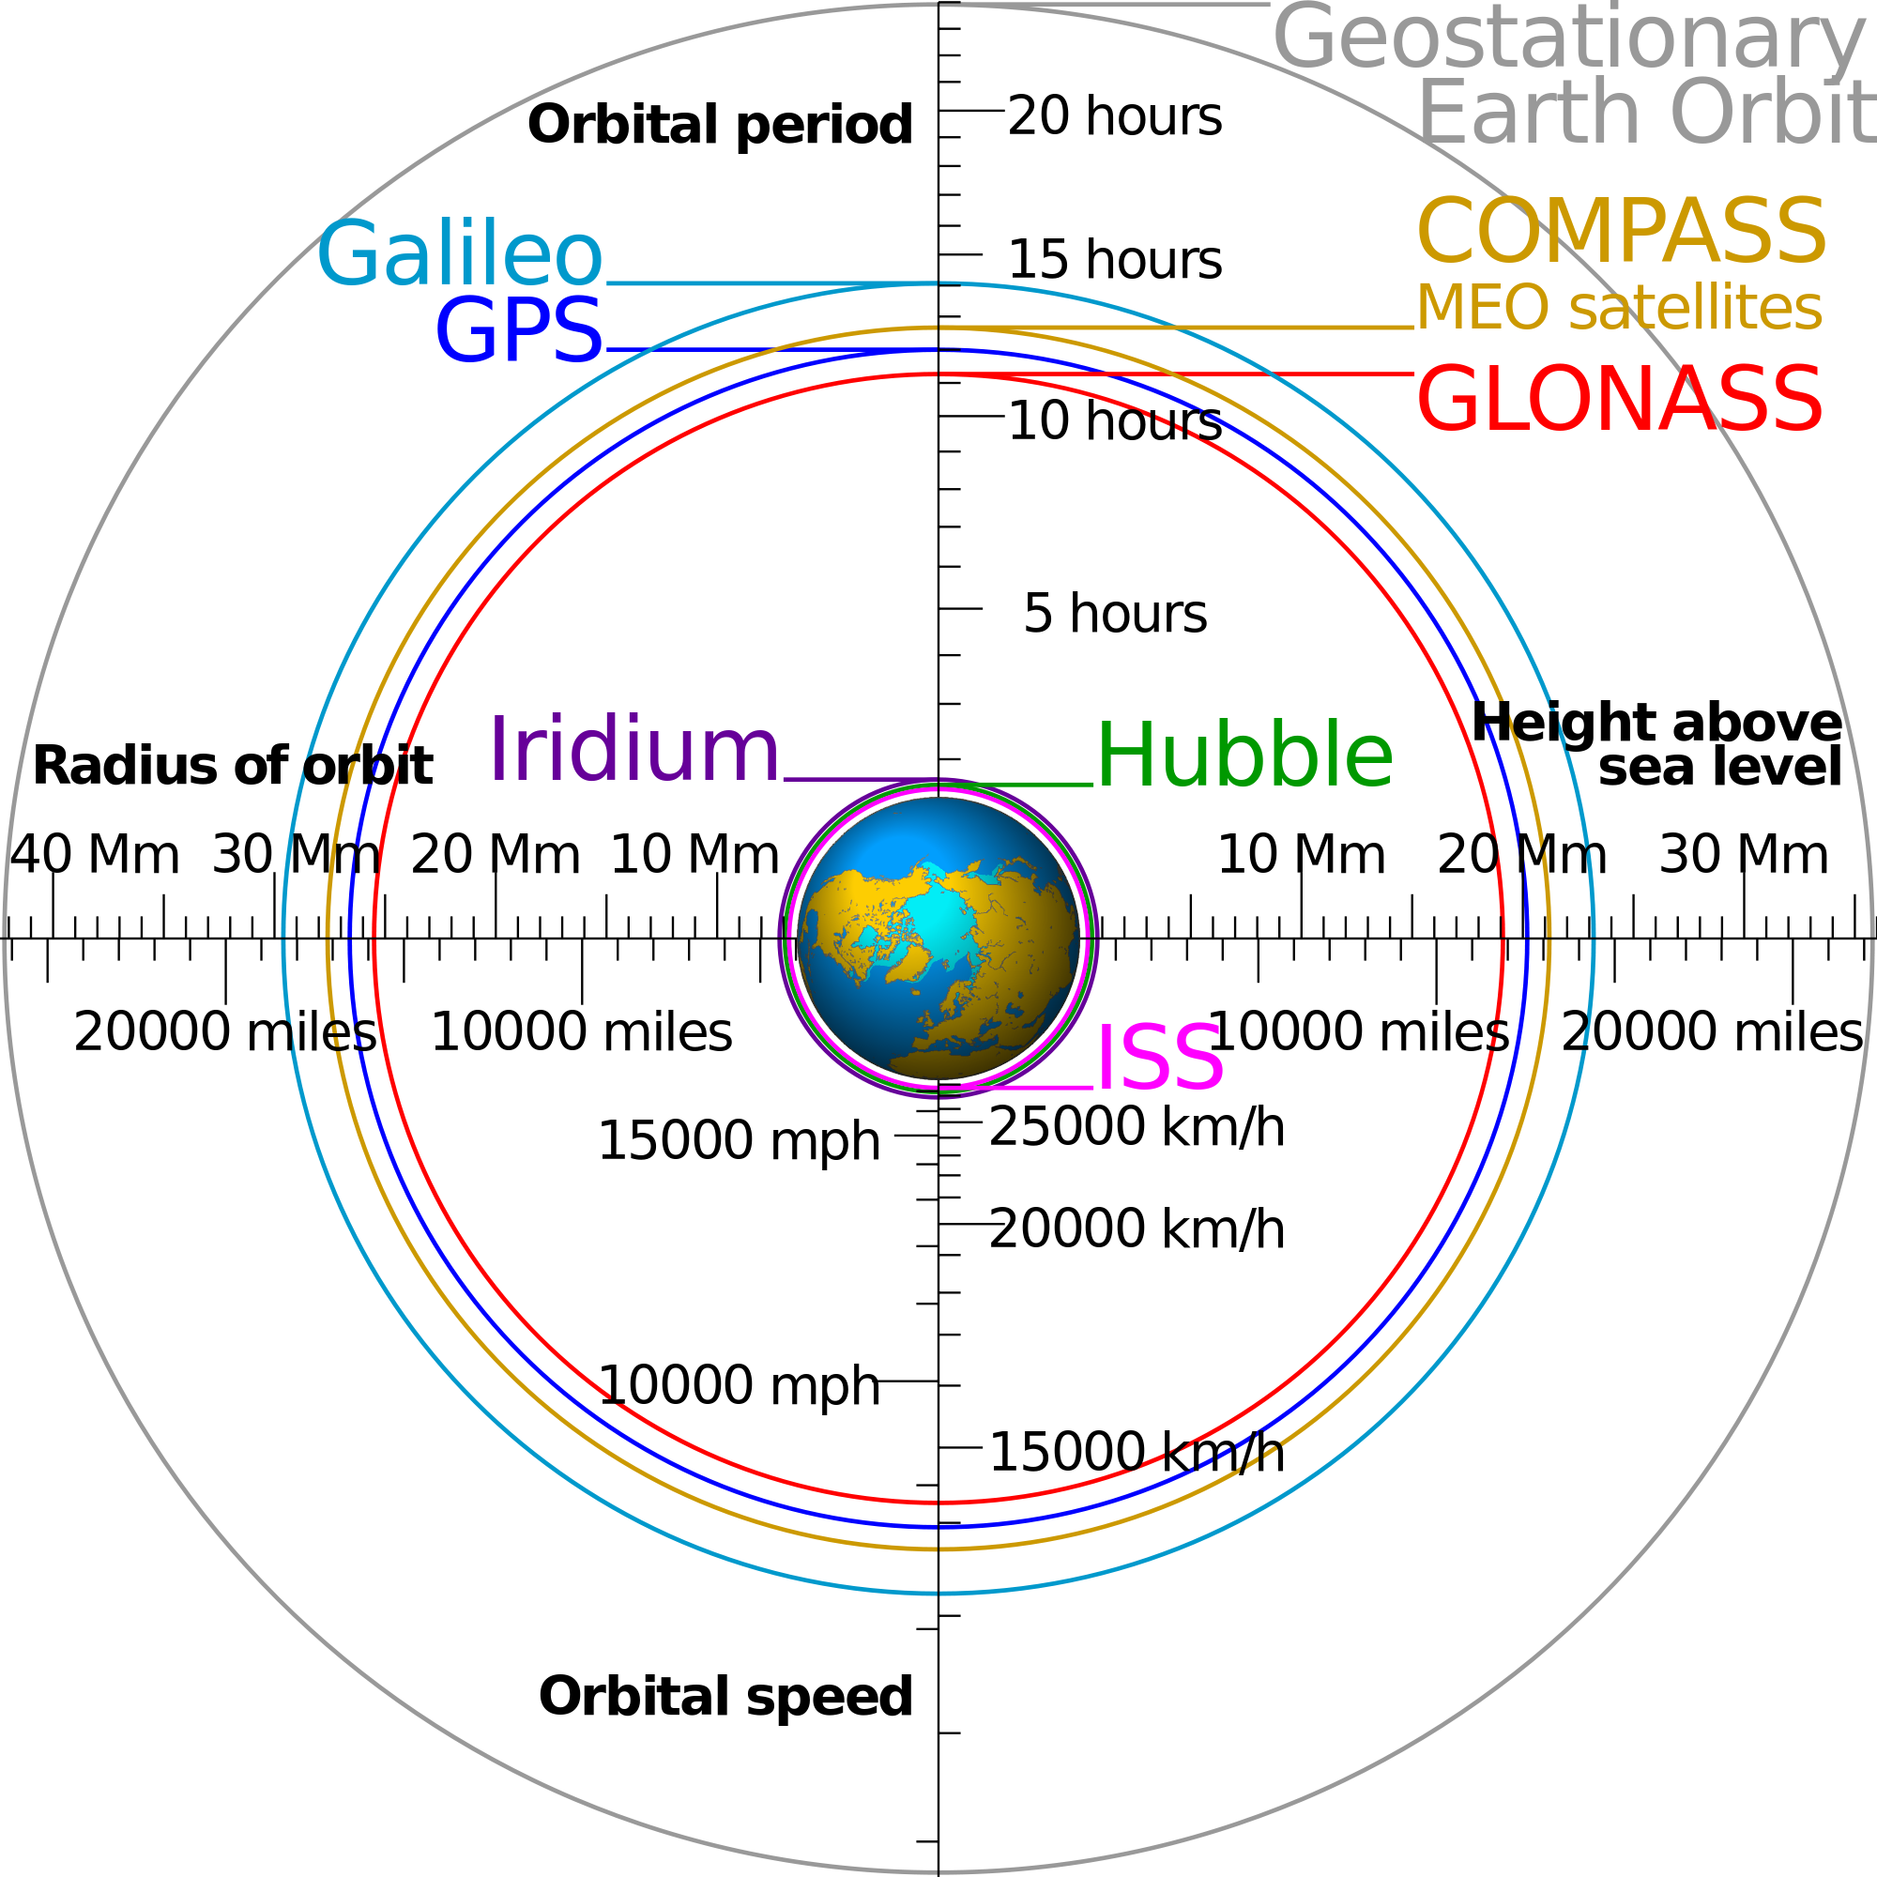
orbits

Slide 10
Orbits
A low Earth orbit (LEO) is generally defined as an orbit below an altitude of 2,000 km. Given the rapid orbital decay of objects below approximately 200 km, the commonly accepted definition for LEO is between 160–2,000 km (100–1,240 miles) above the Earth's surface.
Medium Earth orbit (MEO), sometimes called intermediate circular orbit (ICO), is the region of space around the Earth above low Earth orbit (altitude of 2,000 kilometres (1,243 mi)) and below geostationary orbit (altitude of 35,786 km (22,236 mi)).

Slide 11
Orbit classification based on inclination
Inclined orbit: An orbit whose inclination in reference to the equatorial plane is not zero degrees.
Polar orbit: An orbit that passes above or nearly above both poles of the planet on each revolution. Therefore it has an inclination of (or very close to) 90 degrees.
Polar sun synchronous orbit: A nearly polar orbit that passes the equator at the same local time on every pass. Useful for image taking satellites because shadows will be nearly the same on every pass.
DMSP satellites

Slide 12
GTO
A geosynchronous transfer orbit or geostationary transfer orbit (GTO) is a Hohmann transfer orbit used to reach geosynchronous or geostationary orbit. It is a highly elliptical Earth orbit with apogee of 42,164 km (26,199 mi). (geostationary (GEO) altitude, 35,786 km (22,000 mi) above sea level) and an argument of perigee such that apogee occurs on or near the equator. Perigee can be anywhere above the atmosphere, but is usually limited to only a few hundred km above the Earth's surface to reduce launcher delta-v (V) requirements and to limit the orbital lifetime of the spent booster.
SDO
The rapid cadence and continuous coverage required for SDO observations led to placing the satellite into an inclined geosynchronous orbit

Slide 13
Van Allen Probes
Highly elliptical orbits at 11 degree inclination from the equatorial plane

Slide 14
Other types of orbits
Heliocentric orbit: An orbit around the Sun.
STEREO A and STEREO B
Interplanetary space
At different planets

Slide 15
Orbit/Mission Design
New Horizon to Pluto
http://www.nasa.gov/mission_pages/newhorizons/main/index.html
http://www.jhu.edu/jhumag/1105web/pluto.html
Dr. Yanping Guo, a mission design specialist at APL
Reduce the journey by three years

Slide 16
Space Weather impacts on spacecraft operation
Notes:
Single event effects, internal charging, surface charging, event total dose.
Single event effects (SEE) are caused by protons and heavy ions with energies of 10s of MeV/amu; internal charging is caused by highly dynamic belts of electrons with energies above about 100 keV that penetrate inside a vehicle; surface charging is caused by electrons with energies of 10s of keV that interact with spacecraft surfaces; event total dose iscaused primarily by solar protons and possibly also by transient belts of trapped particles, typically protons with energies near 10 MeV.

Slide 17
Increasing dependence on satellites

Slide 18
Missions lost/Terminated Due to Space Environment
Vehicle date diagnosis
DSCSII (9431) Feb 73 surface ESD
GOES4 Nov 82 surface ESD
DSP Flight 7 Jan 85 surface ESD
Feng Yun 1 Jun 88 ESD
MARECS A Mar 91 surface ESD
MSTI Jan 93 single event effects
Hipparcos Aug 93 total radiation dose
Olympus Aug 93 micrometeoroid impact
SEDS 2* Mar 94 micrometeoroid impact
MSTI 2 Mar 94 micrometeoroid impact
IRON 9906 1997 single event effect
INSAT 2D Oct 97 surface ESD
Notes:
Historical record

Slide 19
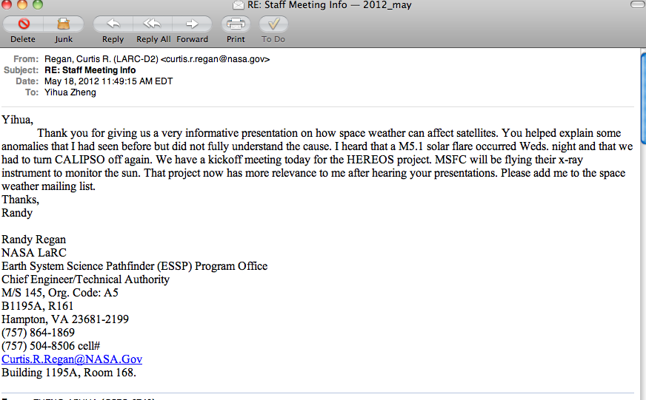
Importance of SWx Services

Slide 20
Space Environment Model Use in Mission Life Cycle
Mission Concept
Mission Planning
Design
Launch
Operations
Anomaly Resolution
Space Climate
Minimize Risk
NASA SWx services
Space Weather
Manage Residual Risk
Both
+
in situ
measurements
Acknowledge: Mike Xapsos

Slide 21
SWx Services provided by NASA/SWC

Slide 22
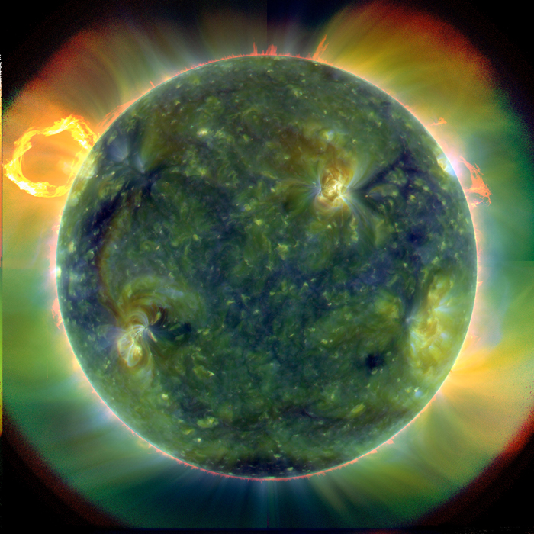
NASA SWC: Types of SWx Services
Providing assistance in spacecraft anomaly resolution by assessing whether space weather has any role in causing the observed anomaly/anomalies.
Sending out weekly space weather reports/summaries to NASA mission operators, NASA officials and involved personnel.
Space Weather

Slide 23
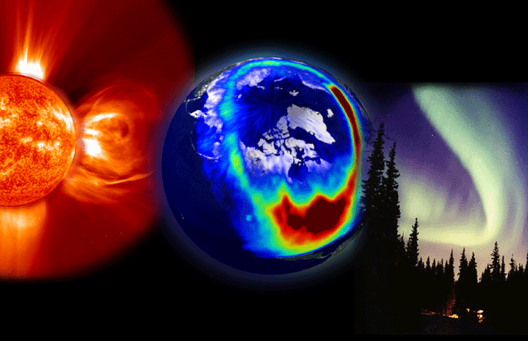
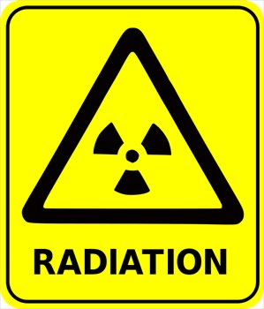
Types of SWx Services
- continued
3. Sending out timely space weather alerts/forecasts regarding adverse conditions throughout the solar system, such as significant CME events, elevated radiation levels, etc.
4. Providing general space weather support for NASA customers.

Slide 24
Seven types SWx impacts for robotic missions
Spacecraft surface charging caused by low-energy (< 100 keV) electrons, which are abundant, for example, in the inner magnetosphere during magnetospheric substorms.
Spacecraft internal electrostatic discharge caused by high-energy electrons (> 100 keV) that exist, for example, in the dynamic outer radiation belt of the Earth.
Single event effects due to high-energy (> 10 MeV) protons and heavier ions generated, for example, in solar flares and in coronal mass ejection (CME) shock fronts.
Total dosage effects caused by cumulative charged particle radiation received by spacecraft.
Increased spacecraft drag caused by the thermal expansion of the Earth’s upper atmosphere during space weather storms.
Communication disruptions between ground stations and spacecraft due to ionospheric irregularities
Attitude control disruptions caused, for example, by large storm-time magnetic field fluctuations in the geostationary orbit.
Feedback from our annual SWx workshop for robotic missions

Slide 25
SWx impacts on sc (cont’d)
low-energy protons (< 10 MeV) pose a problem due to trapping into charge-coupled device (CCD) substrates.
➔ virtually any part of electron and ion spectra ranging from low to relativistic energies can impact spacecraft operations.

Slide 26
Space Environment Anomalies
According to a study by the Aerospace Corporation the 2 most common types of spacecraft anomalies by far are due to electrostatic discharge (ESD) and single event effects (SEE)
Reported results*:
Anomaly Type: | Number of Occurrences:
ESD | 162
SEE | 85
Total Dose and Damage | 16
Miscellaneous | 36
* H.C. Koons et al., 6th Spacecraft Technology Conference, AFRL-VS-TR-20001578, Sept. 2000

Slide 27
surface charging: which can lead to electrostatic discharges (ESD), ESD: can lead to a variety of problems, including component failure and phantom commands in spacecraft electronics [Purvis et al., 1984].
Surface Charging
Purvis, C. K., H. B. Garrett, A. C. Wittlesey, and N. J. Stevens (1984),
Design guidelines for assessing and controlling spacecraft charging
effects, NASA Tech. Pap. 2361
https://standards.nasa.gov/documents/detail/3314877

Slide 28
Surface Charging (SC)
Commercial satellite anomaly
More often in the midnight to morning sector
<100 keV e- distribution: similar behavior as SC anomalies
=> Surface charging might be the main cause of the anomalies.
Choi, H.‐S., J. Lee, K.‐S. Cho, Y.‐S. Kwak, I.‐H. Cho, Y.‐D. Park, Y.‐H. Kim, D. N. Baker, G. D. Reeves, and D.‐K. Lee (2011), Analysis of GEO spacecraft anomalies: Space weather relationships, Space Weather, 9, S06001,doi:10.1029/2010SW000597.
Substorm injections ( Aurora)

Slide 29
Surface Charging Hazards distribution

Slide 30
NASA Doc on Mitigating charging effects
Title: Mitigating In-Space Charging Effects-A Guideline
Document Date: 2011-03-03
Revalid and Reaffirmed Date: 2016-03-03
Revision: A
Organization: NASA

Slide 31
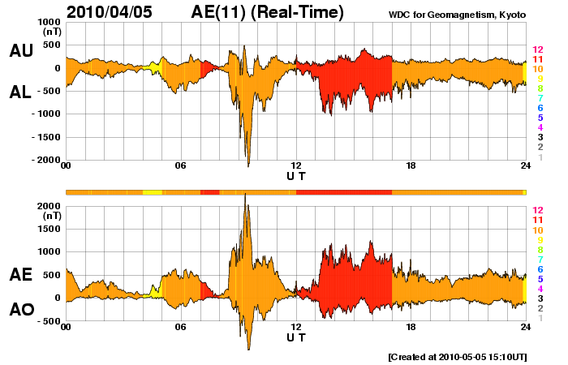
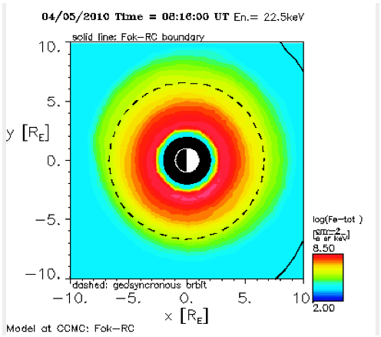
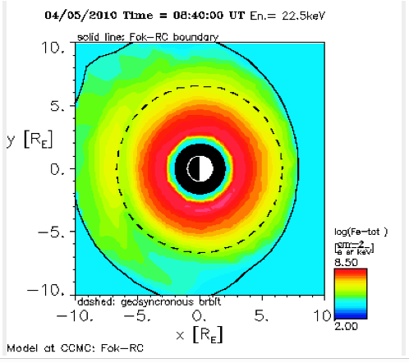
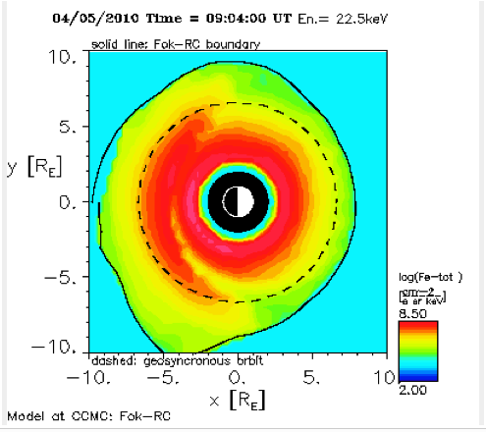
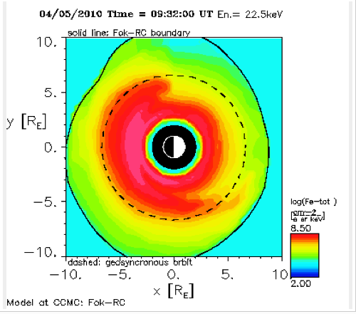
Galaxy 15 failure on April 5, 2010
- surface charging might play a role
22keV electrons 4/5, 8:16-9:32Z
Galaxy 15 failed approx 9:48Z
Ring current model data show same

Slide 32
Environmental Source of SEEs
Single Event Environments in Space
Galactic Cosmic Rays
Solar Particle Events (flare/CME)
Trapped Protons in the inner belt (1 – 3 RE)

Slide 33
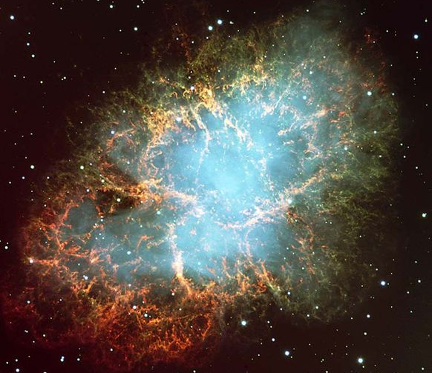
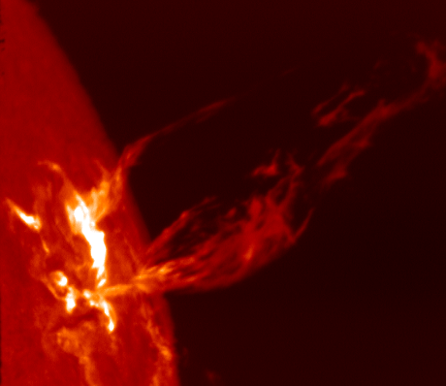
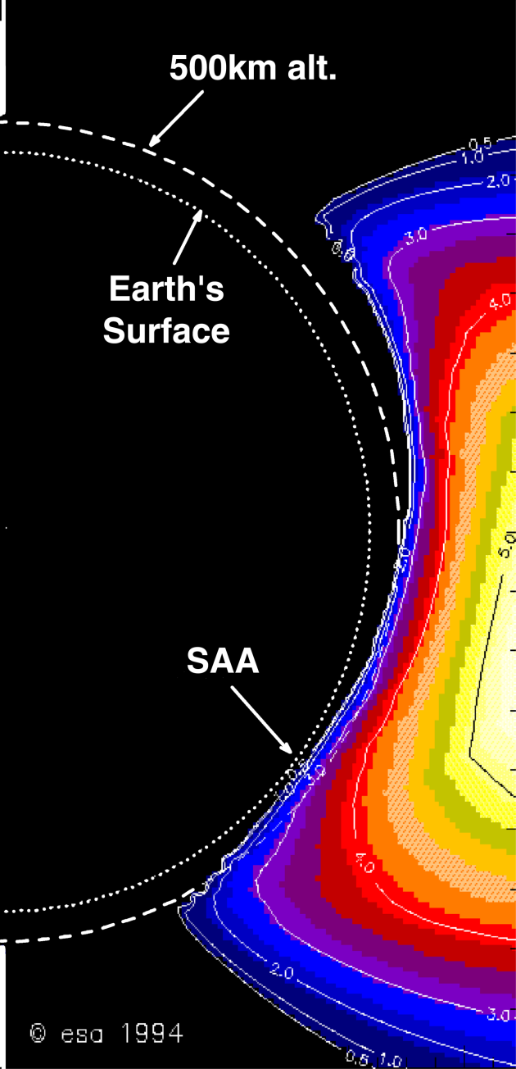
SEE source in Space
High Energy
Particle
Radiation
Galactic
Cosmic Rays
Solar Particle
Events (flare/CME)
Trapped
Particles (SAA)
Most unpredictable

Slide 34
Galactic Cosmic Rays
Galactic cosmic rays (GCR) are high-energy charged particles that originate outside our solar system.
Supernova explosions are a significant source
Anticorrelation with solar activity
More pronounced/intense during solar minimum

Slide 35
South Atlantic Anomaly
Dominates the radiation environment for altitudes less than about 1000 km.
Caused by tilt and shift of geomagnetic axis relative to rotational axis.
Inner edge of proton belt is at lower altitudes south and east of Brazil.
E.J. Daly et al., IEEE TNS, April 1996

Slide 36
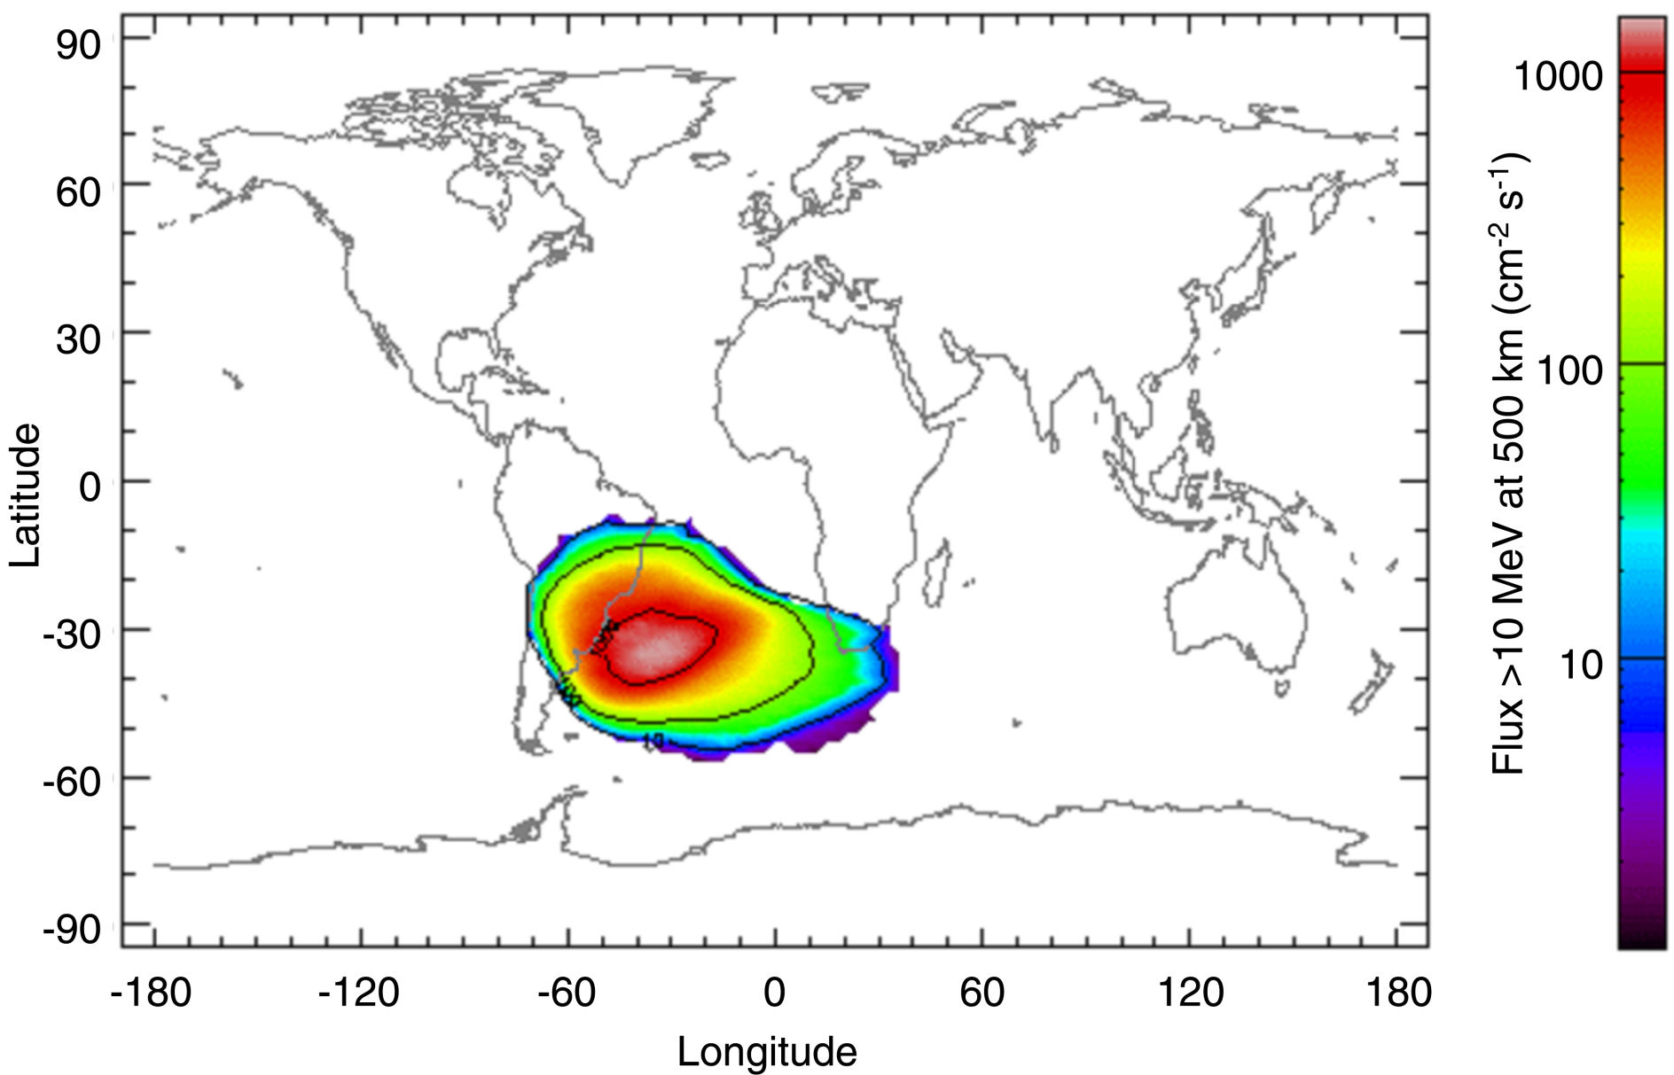
South Atlantic Anomaly
Solar Maximum
From SPENVIS, http://www.spenvis.oma.be/

Slide 37
Solar Particle Events
Caused by flare/CME

Slide 38
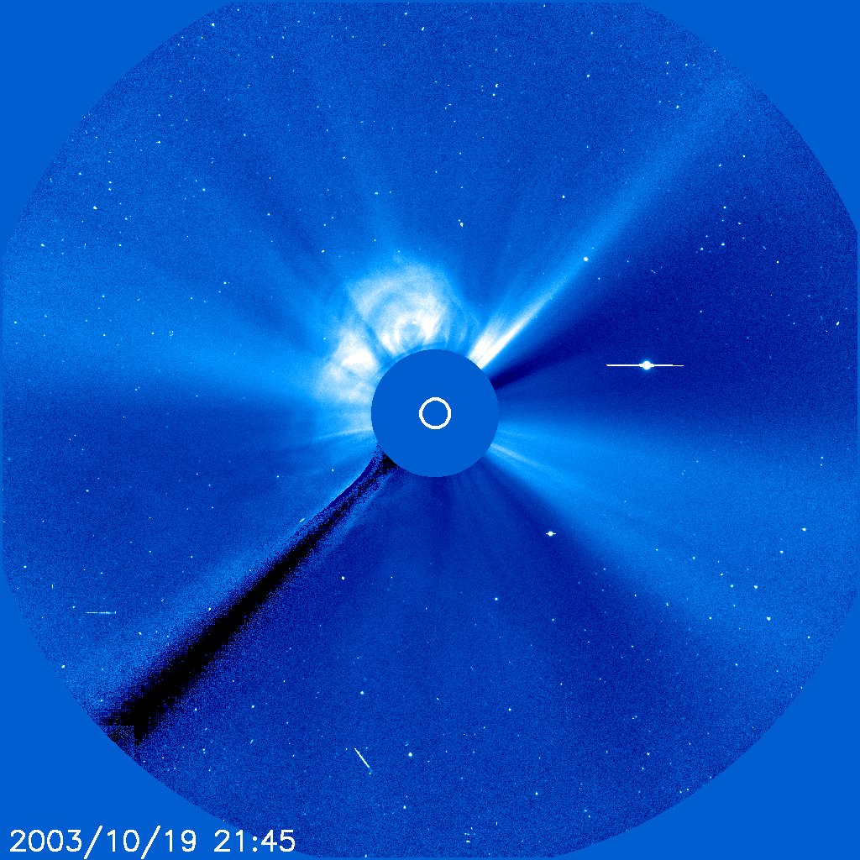
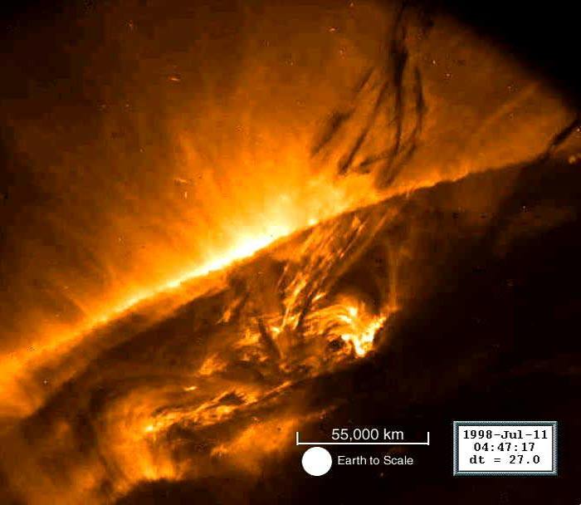
Characteristics of SEPs
Elemental composition* (may vary event by event)
96.4% protons
3.5% alpha particles
0.1% heavier ions (not to be neglected!)
Energies: up to ~ GeV/nucleon
Event magnitudes:
> 10 MeV/nucleon integral fluence: can exceed 10⁹ cm⁻²
> 10 MeV/nucleon peak flux: can exceed 10⁵ cm⁻²s⁻¹

Slide 39
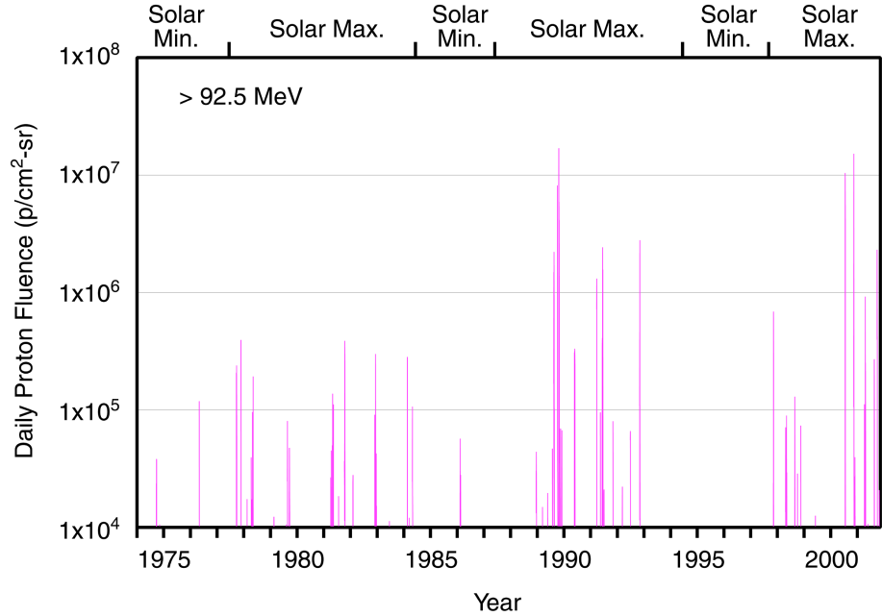
Solar Cycle Dependence
Most unpredictable

Slide 40
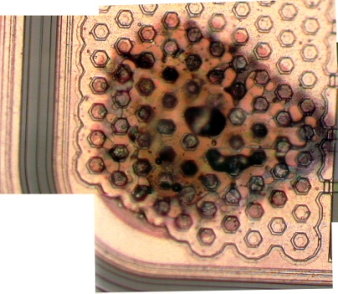
What is a Single Event Effect?
Single Event Effect (SEE) – any measureable effect in a circuit caused by single incident ion
Non-destructive – SEU (Single Event Upset), SET (single event transients), MBU (Multiple Bit Upsets), SHE (single-event hard error)
Destructive – SEL (single event latchup), SEGR (single event gate rupture), SEB (single event burnout)
Destructive event
in a COTS 120V
DC-DC Converter
(credit: M.Xapsos)

Slide 41
Single Event Upsets
SEUs: are soft errors, and non-destructive. They normally appear as transient pulses in logic or support circuitry, or as bitflips in memory cells or registers.

Slide 42
Destructive SEEs
Several types of hard errors, potentially destructive, can appear:
Single Event Latchup (SEL) results in a high operating current, above device specifications, and must be cleared by a power reset.
Other hard errors include Burnout of power MOSFETS (Metal Oxide Semiconductor Field-Effect Transistor) , Gate Rupture, frozen bits, and noise in CCDs.

Slide 43
Anomalies March 2012 SWx events SEEs dominate
Quite a few NASA spacecraft experienced anomalies, majority of which are SEEs. Some of them required reset/reboot.
Details to be discussed later.

Slide 44
Internal Charging
- energetic electrons in the outer radiation belt
CIR HSS geomagnetic storm
CME geomagnetic storms

Slide 45
Operator response to SWx impacts spacecraft specific/instrument specific depends on which region/where the spacecraft is.

Slide 46
Human Safety in Space
GCR
SEP
Johnson Space Center/Space Radiation Analysis Group (SRAG)
Limit: the > 100 MeV flux exceeding 1pfu
(1 pfu = 1 particle flux unit= 1/cm^2/sec/sr)
All clear (EVA –extravehicular activity)

Slide 47
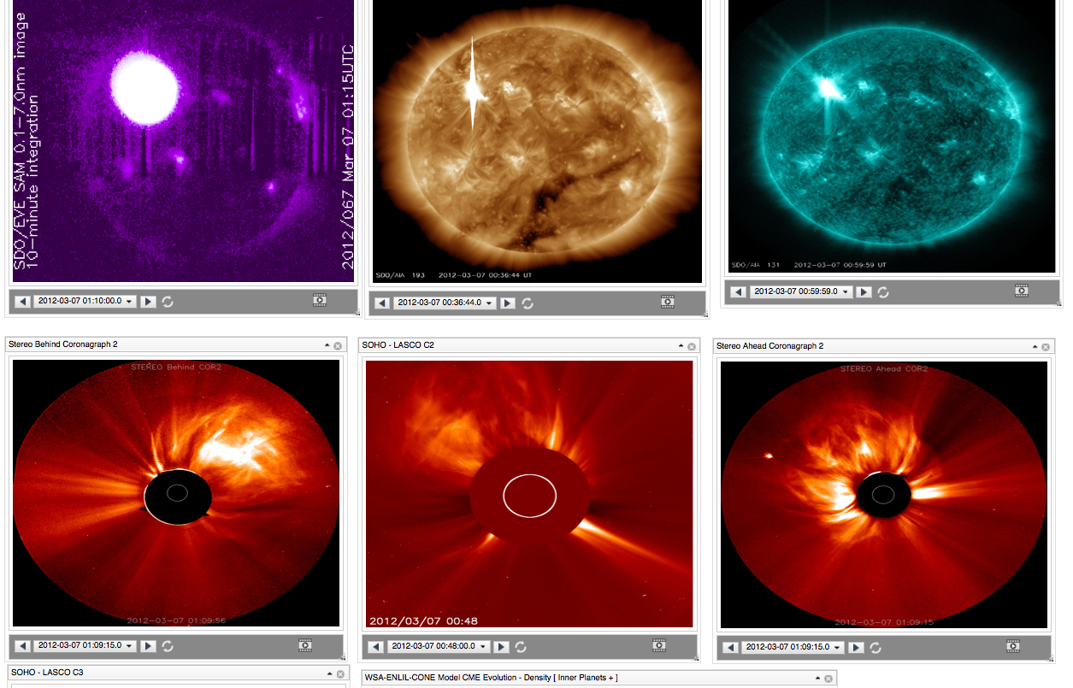
March 7 flares/CMEs

Slide 48
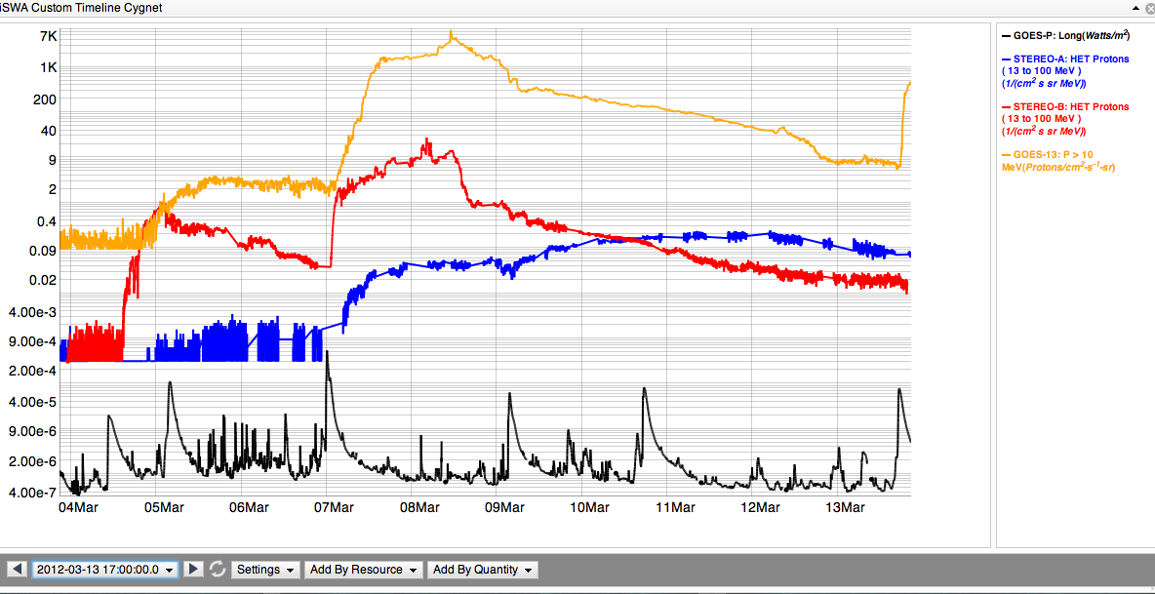
SEP: proton radiation (flare and CME)
GOES >10 MeV
13-100 MeV STEREO B
13-100 MeV STEREO A
X5.4/2200 km/s
X1.3/1800 km/s
M7.9
VCME=2100 km/s
X1.1
VCME=1360 km/s
M8.4
VCME=1500 km/s
M2.0
VCME=1540 km/s
M6.3/CME=1125 km/s
GOES x-ray

Slide 49
Major events from the long-lasting AR1429 during March 4 – 28, 2012

Slide 50
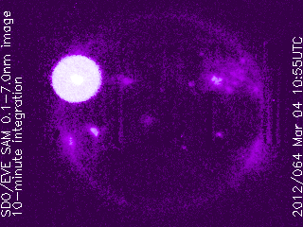
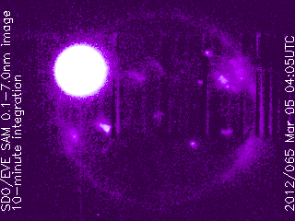
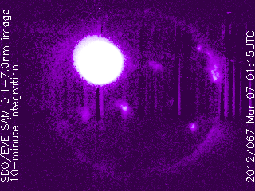
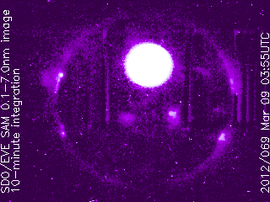
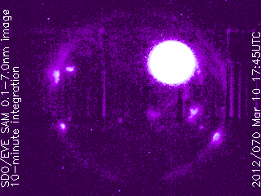
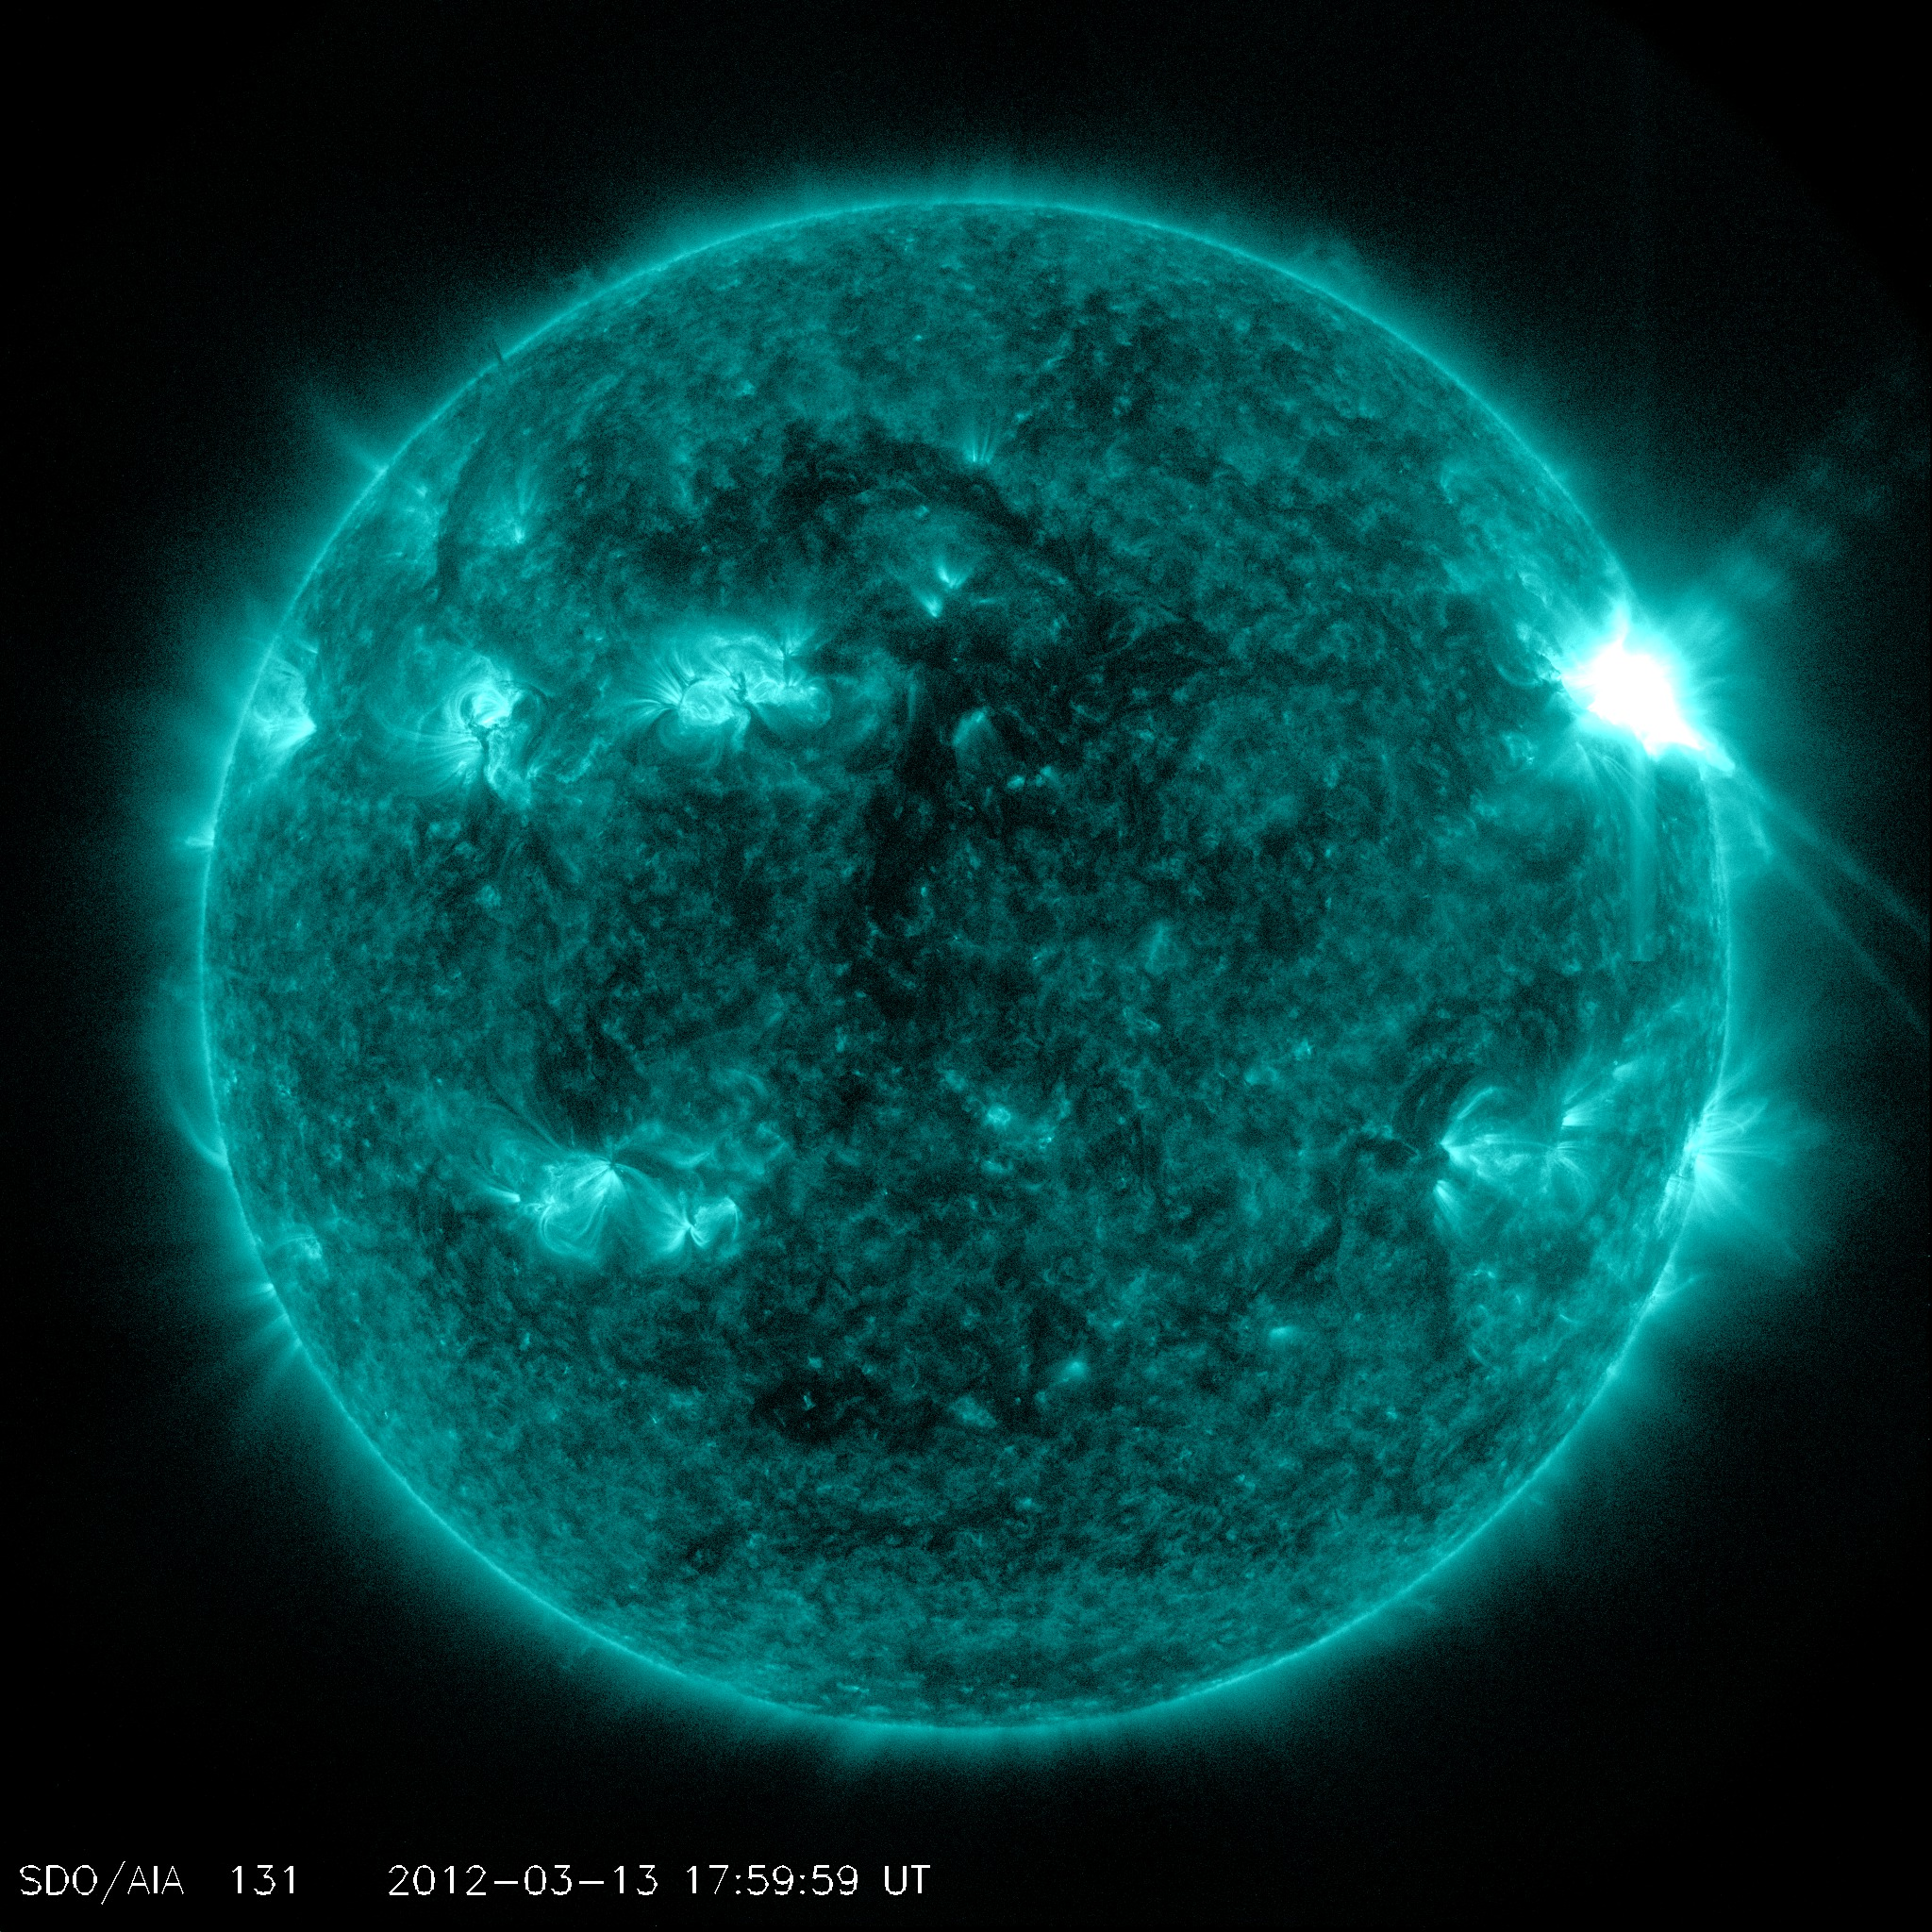
Flares of the Major Earth-Facing Events viewed by SDO EVE (x-ray)
M2.0, 2012-03-04
X1.1, 2012-03-05
X5.4/X1.3 2012-03-07
M6.3, 2012-03-09
M8.4, 2012-03-10
M7.9, 2012-03-13

Slide 51
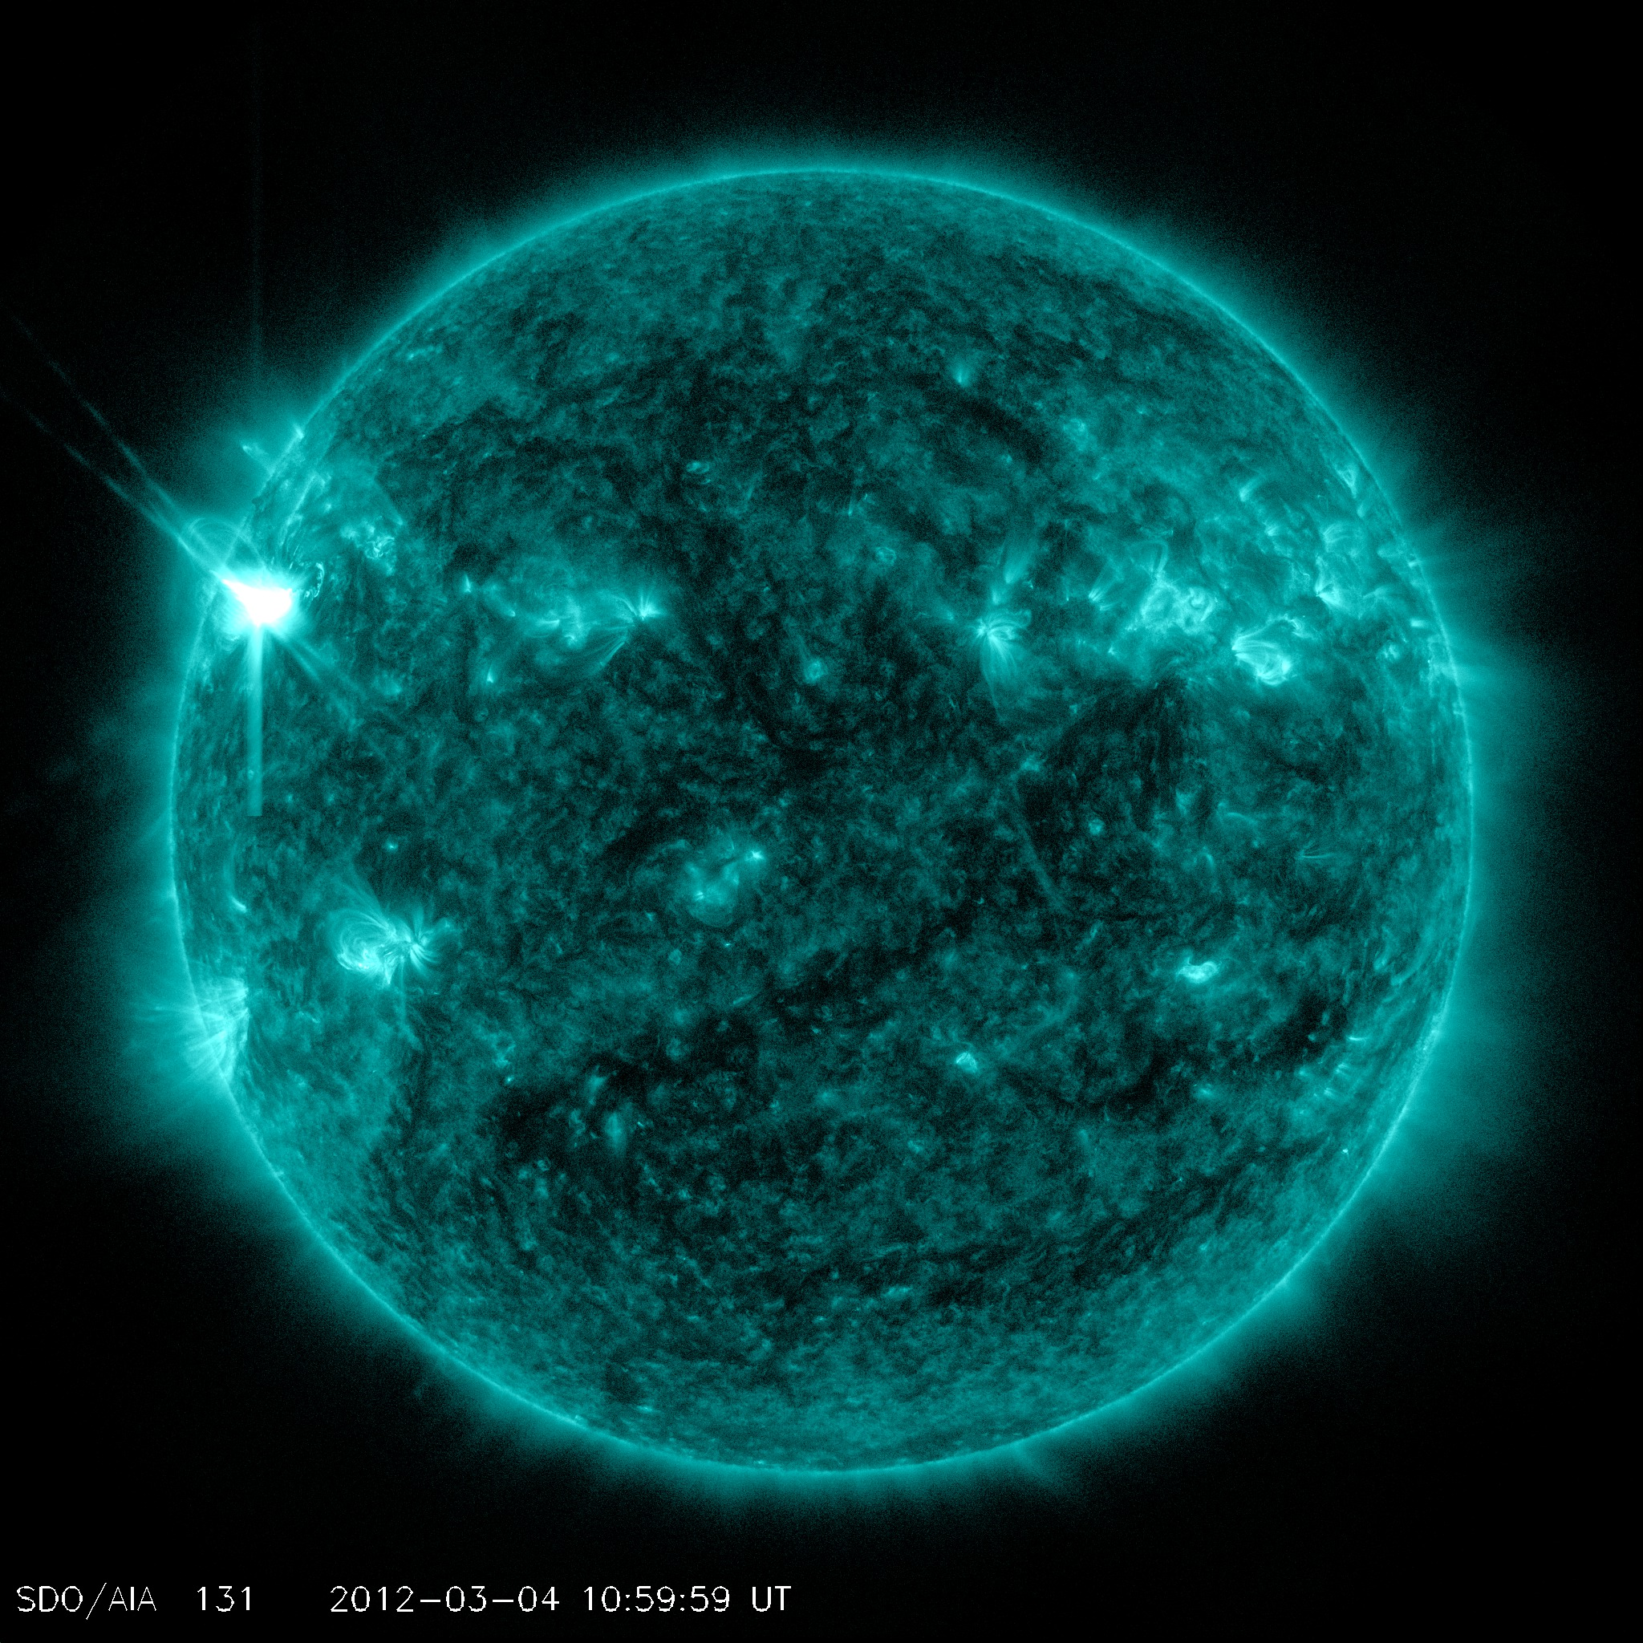
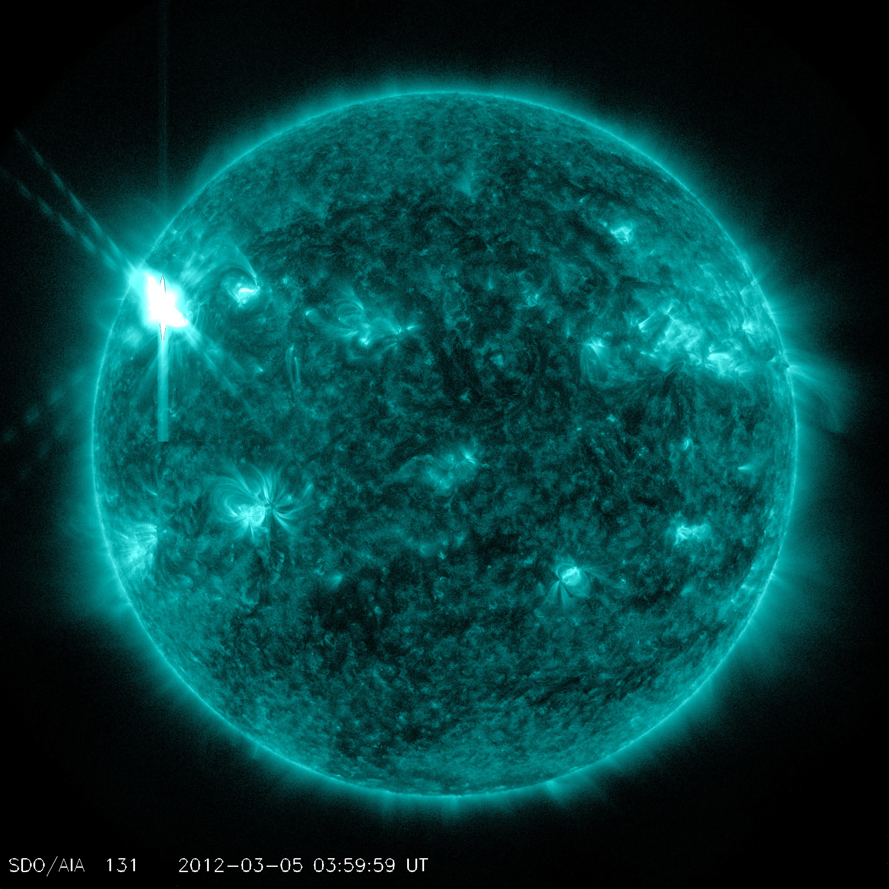
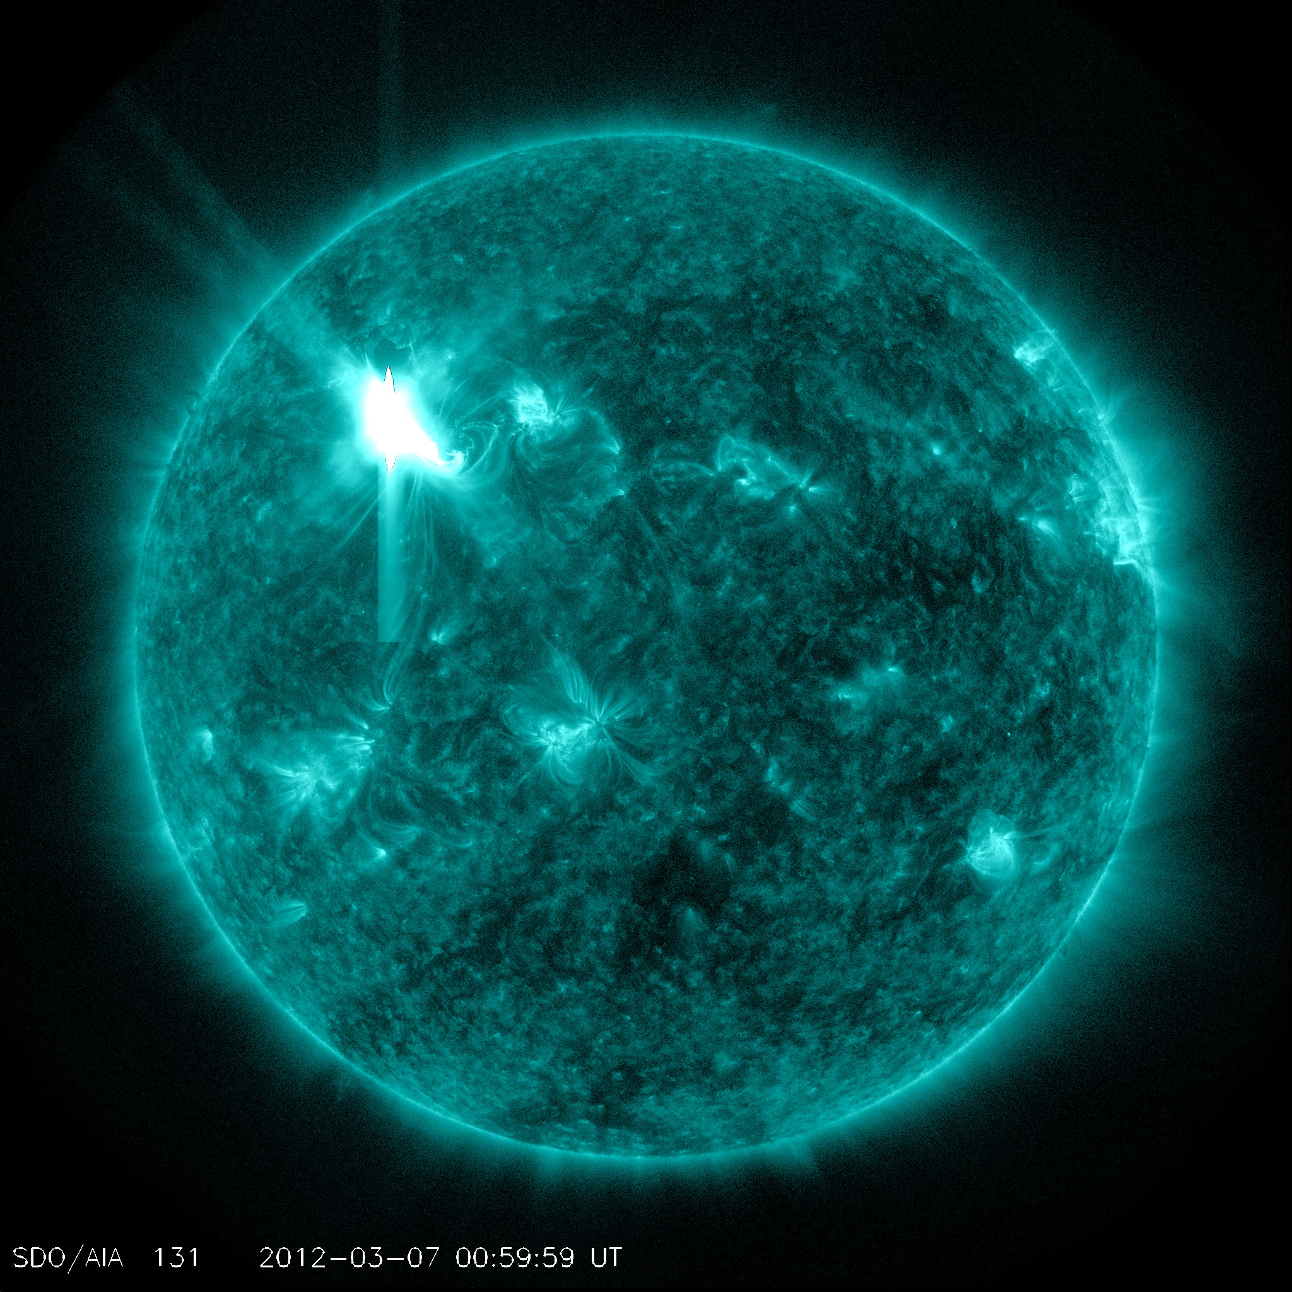
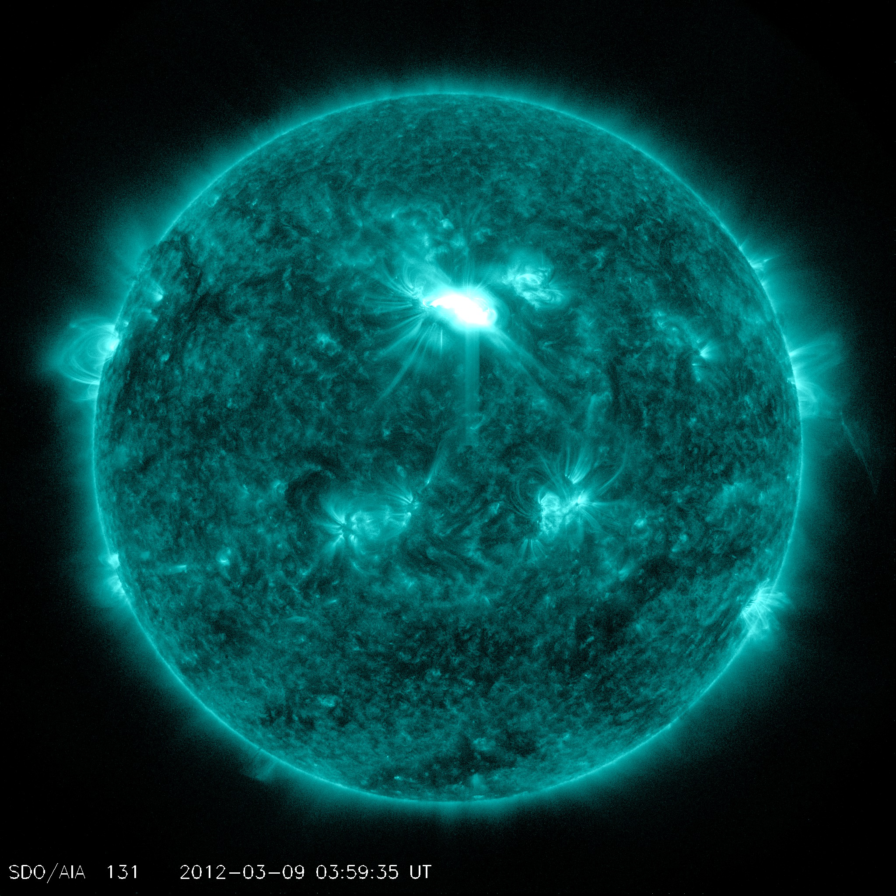
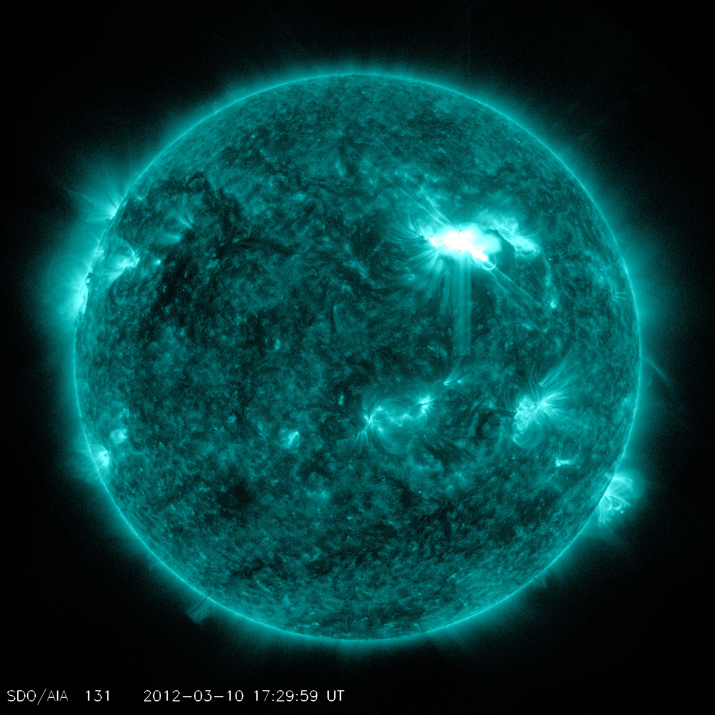
Flares of the Major Earth-Facing Events viewed by SDO AIA 131
M2.0, 2012-03-04
X1.1, 2012-03-05
X5.4/X1.3 2012-03-07
M6.3, 2012-03-09
M8.4, 2012-03-10
M7.9, 2012-03-13

Slide 52
Orientation
West 90
Earth
East 90

Slide 53
The Corresponding CMEs Associated with the Flares
M2.0, 2012-03-04
X1.1, 2012-03-05
X5.4/X1.3 2012-03-07
M6.3, 2012-03-09
M8.4, 2012-03-10
M7.9, 2012-03-13

Slide 54
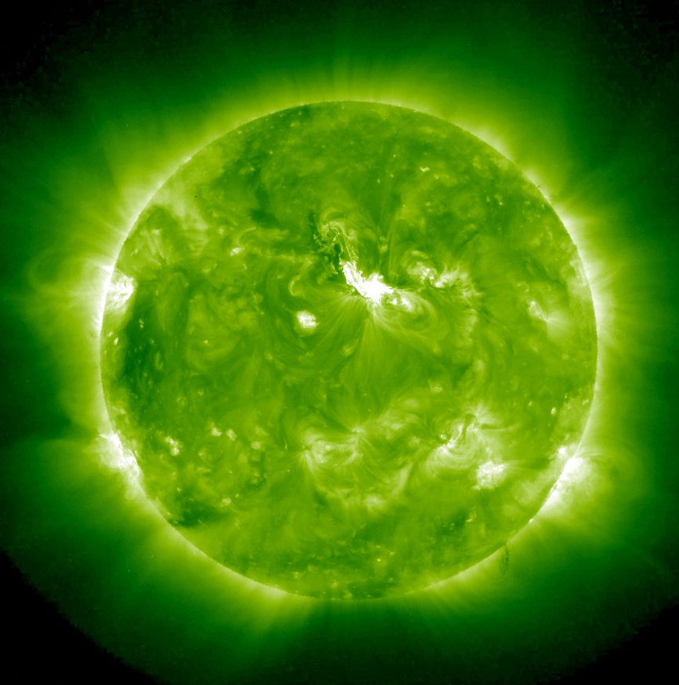
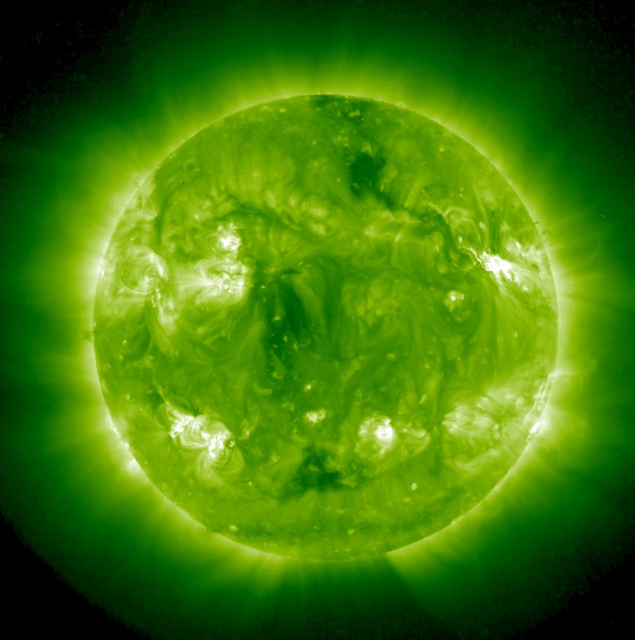
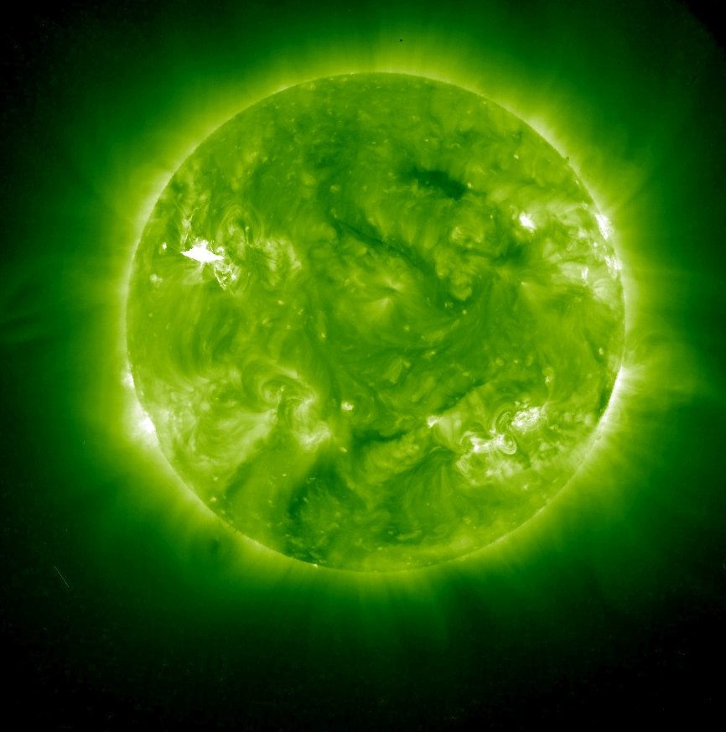
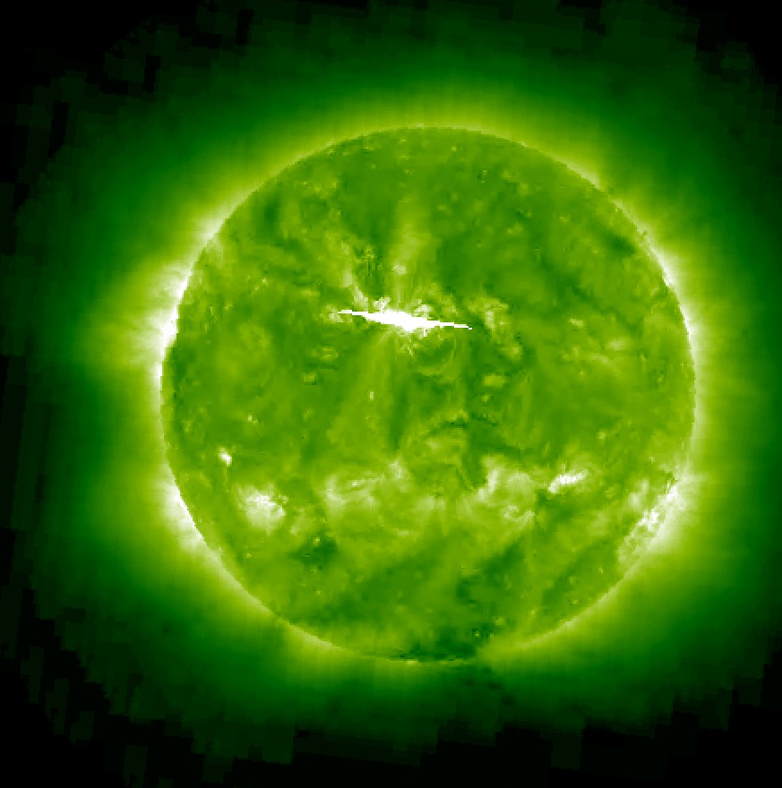
STA: 2012-03-18
STA: 2012-03-21
STB: 2012-03-24
STB: 2012-03-26
Backsided events in STEREO EUVI 195A (top) and CME model simulations (bottom)

Slide 55
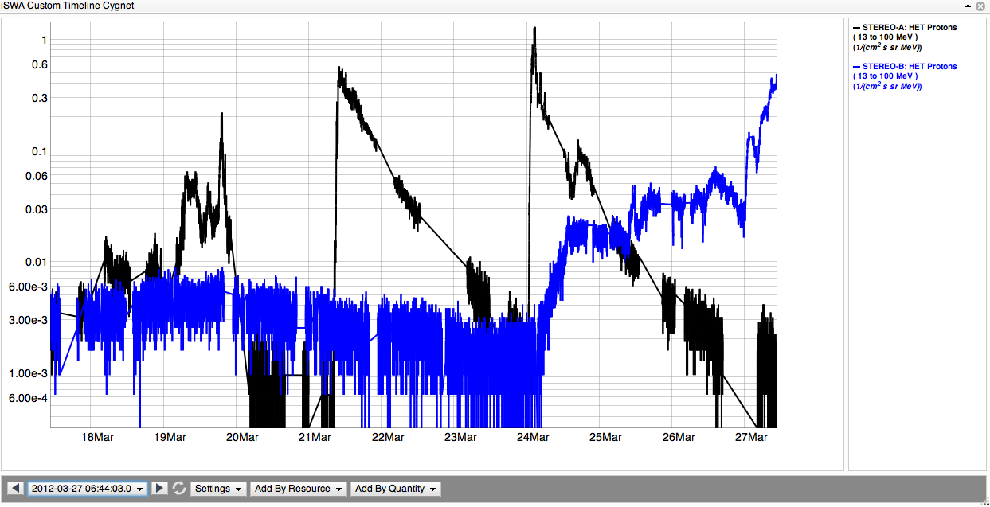
Enhanced proton radiation at STEREO A and B from the backsided events.
2012-03-21 07:39 UT
VCME=1550 km/s
2012-03-24 00:39UT
VCME=1600 km/s
2012-03-26 23:12UT
VCME=1500 km/s
2012-03-18 00:39UT
VCME=1450 km/s
13-100 MeV STEREO A
13-100 MeV STEREO B
Notes:
Enhanced proton radiation at STEREO A and B from the backsided events.

Slide 56
Supplementary Material/contact info
View our video, Incredible Active Region 1429: One for the record books, to learn more about the activities from this region from March 4 – March 28, 2012. http://youtu.be/PbyJswbX4VA
This video has been updated at the following link: http://youtu.be/dxl5drPY8xQ (And also available on http://vimeo.com/nasaswc/ar1429)
Summary Video of the March 7, 2012 event
http://youtu.be/HeoKf6NfEJI
Full text of event summary
http://goo.gl/dTnfd
NASA Space Weather Center
http://swc.gsfc.nasa.gov/main/

Slide 57
homework
Name all types of space weather impacts on spacecraft and their potential causes
Types of spacecraft orbits
Go over the summary video of the 7 March 2012 event - can you give a 30 seconds – 1minute description of the event to a friend?
Go over the video of ‘Incredible Active Region 1429’ – can you give a 30s – 1min description in your own words?

Slide 58
Spacecraft Anomalies due to the March Solar Activities
Acknowledge: feedback from people involved in robotic missions

Slide 59
Orientation

Slide 60
Interplanetary missions MESSENGER
11 instances of anomalous behavior have been identified to be associated with the increased solar activity in early March 2012.
The spacecraft attitude control system (ACS) and 5 of the seven science instruments were temporarily affected, but all were quickly returned to nominal operations.
The Magnetometer (MAG) and the Mercury Laser Altimeter (MLA) were the only instruments that showed no adverse effects.
Peter Bedini APL

Slide 61
Interplanetary missions MESSENGER
MESSENGER/FIPS (The Fast Imaging Plasma Spectrometer) experienced ~ 7 SEU in its flight software memory, one of which was critical to require reboot
The instrument microchannel plate bias voltage spontaneously lowered below the threshold (at 2012-03-07T 04:40 UT, shortly after the two x-class flare/CME/SEP event) where counting takes place. So all data collection stopped.
Jim Raines, U. Michigan

Slide 62
Interplanetary missions
JUNO – no anomalies
STEREO A
SECCHI instrument reset at 2012-03-09 04:12:00Z
27th since launch, suspect not environmentally induced.
WIND/SMS(STICS and MASS) – reset by internal latchup detection, manually restored on 8 March.
ACE/SWICS and ACE/SWIMS – not affected

Slide 63
Interplanetary missions
Dawn
a possible single event upset of the main camera (often)
Detected significantly increased level of proton flux arriving at spacecraft (on the opposite side of the sun from Earth at about 2.4 AU from the sun).

Slide 64
Lunar missions
LRO
One instrument interrupted by a SEU and a star tracker processor reset. Neither of them can be definitively associated with the solar events, since both have also occurred during quiet solar periods.
GRAIL
(3/7/2012 04:00 UT– 3/9/2012 03:30 UT) MoonKAM on GR-A and GR-B encountered a fault due to enhanced SEP. each was powered off.
Powered on 3/13 (GR-A) and 3/14 (GR-B) after space weather activity subsided.
MoonKAM: EPO purpose, commercial grade – not screened for space radiation environments

Slide 65
Other missions
IBEX-HI
The lowering of the high-voltage on IBEX-HI due to excessive counts
THEMIS
A couple of recurrent anomalies on THEMIS likely caused by energetic electrons
3/11/2012 BAU experienced cold reset – THEMIS E
3/14/2012 BAU PCM packet generation halted – THEMIS D
Loss of data collection
Bus Avionics Unit (BAU)

Slide 66
Earth missions Terra, Aqua,Aura, TRMM, GRACE, SORCE, Clousat
Grace-1
Instrument processing unit (IPU) redundant side failed on 3/9/2012 23:20Z, cause unknown
On-board data handling unit experienced a warm boot on 3/10 02:39:05Z (tentatively believed to be unrelated to IPU failure)
~ 6 hour data loss
Terra
High gain Antenna Motor Drive Assembly is prone to SEUs, typically see 2-3 issues per week regardless of solar activity although does increases during solar activity
Time of Events Lat. Long.
03/01/2012 12:11:19 -13.025 -27.235
03/05/2012 00:53:33 -25.402 -31.916
03/06/2012 12:32:48 -21.865 -33.881
03/06/2012 21:47:59 61.374 -4.586
03/07/2012 19:11:51 56.148 37.311
03/08/2012 05:10:05 75.294 -133.239
03/08/2012 07:45:15 -75.613 -104.779
03/08/2012 15:54:13 -78.804 -127.576
03/08/2012 17:41:45 -66.953 91.896
03/08/2012 19:09:05 -70.565 -153.84
03/13/2012 01:45:06 -16.193 -46.431

Slide 67
Earth missions (cont’d)
JASON-1
On March 3, the satellite entered a safe mode due to an Error Detection and Correction anomaly in a flight software memory location (double-bit error in either EEPROM or RAM). This is a known memory problem originating from Single Event Upsets, and caused similar safe hold transitions to occur in both 2006 and 2009. The satellite currently remains in a safe mode pending a recovery resolution process.
AQUARIUS/SAC-D
The CONAE (Argentina)/SAC-D experienced an altitude control safe mode transition during a planned Aquarius cold sky calibration se quence on 3/14. Determined to be caused by moon intrusion. Not space weather related.

Slide 68
Earth missions (cont’d)
CALIPSO
07 March 2012 08:10 UTC Payload commanded to 'SAFE' mode in response to eruption of Class X5.4 flare
13 March 2012 12:18 UTC Restarted payload computer
13 March 2012 22:56 UTC Payload commanded to 'SAFE' mode in response to eruption of Class M7.9 flare
19 March 2012 11:47 UTC Payload Computer restarted
20 March 2012 16:39 UTC Lasers restarted and normal measurement operations resumed
The CALIPSO payload computer and laser are sensitive to enhanced levels of energetic heavy ions. Significant damage to either of these components is considered a high risk and a threat to the mission.

Slide 69
Happy ones (with mixed feelings)
LRO
Ecstatic with their data collection of SEP from the CRaTER instrument
RAX-2 (NSF cubeSat)
March solar event periods: happily running SWx experiments. Our services helped them plan their experimental campaign
(sad) RAX-2’s flash memory system failed during the Jan 23 solar event (likely cause – SEP radiation)
Peak flux (Jan 23): 6310 pfu at Jan 24 15:30 UT
Peak flux (Mar 7): 6530 pfu at Mar 8: 11:15 UT
Dawn Mission
SEP measurements

Slide 70
Great Science Dataset/Outcome during the March Solar Events too!

Slide 71
Anomaly resolution procedure
Where is the satellite?
Check if SEPs (solar energetic particles) play any role
Any significant flare at the time?
What is the geomagnetic activity?
Scintillation effects?
If the satellite in the radiation belt? What is the flux level? Could it be a factor?

Slide 72
Anomaly case
EO-1 can no longer see recordered data during the back-orbit due to a known failure of our WARP system. We are essentially blind when not in contact with the SC, nor is the housekeeping data recorded. Therefore, we cannot pinpoint when the SEU occurred.On Julian day 159, 1443Z, we executed a successful contact and image return. When we came up on our next pass @ 1610Z we could see we had experienced an anomaly somewhere in the back-orbit. The following alerts were received:FOT saw some SCL warning pages for the mnemonics:WSCLWARNCNT= WARP SCL number of warnings executed WSCLALERTCNT= WARP SCL number of alert cmds executed.XBHYPRTR = XB Hyperion Retries counterXBHYPRTE= XB Hyperion Error counterXBHYPCME = XB HYP command errorWe saw an error saying “WMDL206 CCSTART rej bad state:loCldState 5, at 160/10:27zWe saw that the WARP MD command error counter had tripped and automatically reset.If your team has the time to look at whether the M5.9 flare, geomagnetic storms, or other associated event may have impacted our operations, it would be greatly appreciated. At this point we are speculating this may have been the case. We are in the process of recovering and there has not been a repeat anomaly which would indicate an on-board failure. So it was likely a one-time incident.

