Slide 1
Recap and Space Weather In the Magnetosphere (II)
Yihua Zheng
SW REDI
June 5, 2013

Slide 2
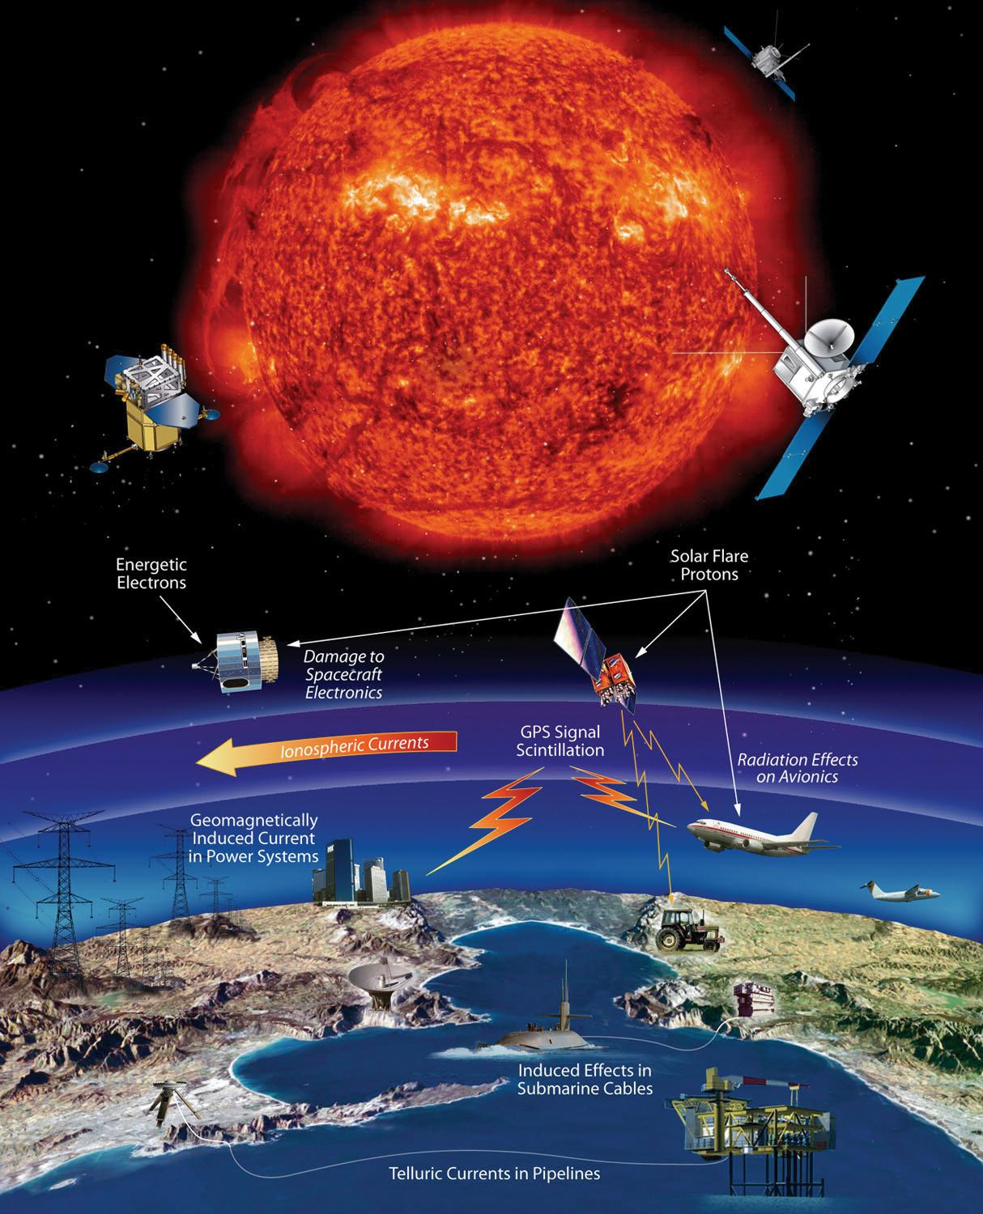
Recap
CME, Flares, and Coronal Hole HSS
The Sun
maker of space weather
Solar energetic protons
CME, Flares, and Coronal Hole HSS
Three very important solar wind disturbances/structures for space weather
Radiation storm
proton radiation (SEP) <flare/CME>
electron radiation <CIR HSS/CME>
Radio blackout storm <flare>
Geomagnetic storm
CME storm (can be severe)
CIR storm (moderate)

Slide 3
Outline
Solar wind +magnetosphere interactions
CIR/HSS and CME impacts on Earth
Importance of magnetosphere in space weather
Geomagnetic storm
CME storm (can be severe)
CIR storm (moderate)

Slide 4
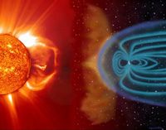
The solar wind pushes and stretches Earth’s magnetic field into a vast, comet-shaped region called the magnetosphere. The magnetosphere and Earth’s atmosphere protect us from the solar wind and other kinds of solar and cosmic radiation.
Flares/CME/High-Speed Streams
Earth’s magnetosphere
Sun

Slide 5
Two Main Drivers for the Magnetosphere
CME (you have seen plenty of them already)
CIR (Corotating Interaction Region) High Speed solar wind Stream (HSS)
Geomagnetic storm
CME storm (can be severe) Kp can reach 9
CIR storm (moderate) Kp at most 6

Slide 6
CME Example
March 7, 2012 CMEs associated with two x-class flares
iSWA layout
Associated with an Active Region

Slide 7
CME from Filament eruption
A movie
Northeast (upper left) quadrant starting around 19:00 UT on Feb 10, 2012
Notes:
Not associated with a specific active region – from a large scale filament eruption

Slide 8
The associated CME
STEREO B
SOHO
STEREO A
Heart-shaped

Slide 9
Coronal Hole HSS
Is one important space weather contributor too!
Particularly for its role in enhancing electron radiation levels near GEO orbit and for substantial energy input into the Earth’s upper atmosphere
May be more hazardous to Earth-orbiting satellites than CME-related magnetic storm particles and solar energetic particles (SEP)

Slide 10
CIR and HSS
Co-rotating Interactive Regions (CIRs) are regions within the solar wind where streams of material moving at different speeds collide and interact with each other. The speed of the solar wind varies from less than 300 km/s (about half a million miles per hour) to over 800 km/s depending upon the conditions in the corona where the solar wind has its source. Low speed winds come from the regions above helmet streamers while high speed winds come from coronal holes.
As the Sun rotates these various streams rotate as well (co-rotation) and produce a pattern in the solar wind much like that of a rotating lawn sprinkler. However, if a slow moving stream is followed by a fast moving stream the faster moving material will catch-up to the slower material and plow into it. This interaction produces shock waves that can accelerate particles to very high speeds (energies).

Slide 11
west
east

Slide 12
Coronal Hole HSS
Mar 1, 2011
June 4, 2012

Slide 13
Forecasting capability enabled by ENLIL
WSA+ENLIL+cone
WSA+ENLIL
Predicting impacts of CMEs
Modeling and predicting the ambient solar wind

Slide 14
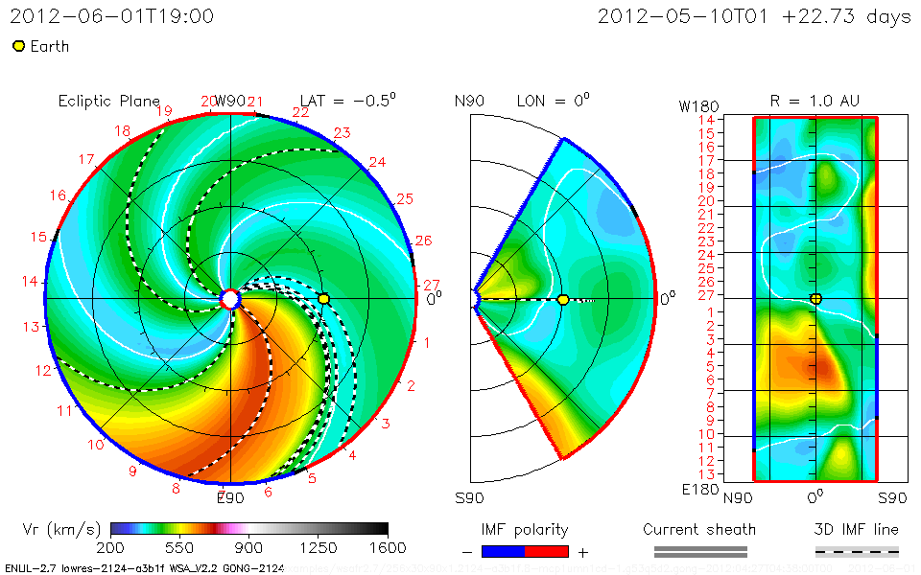
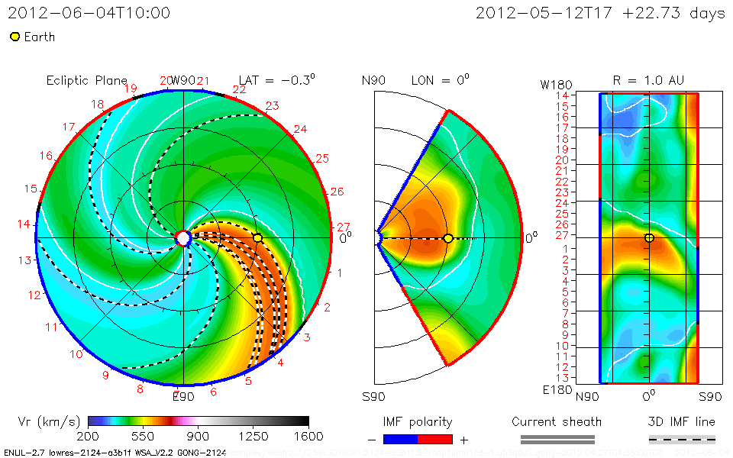
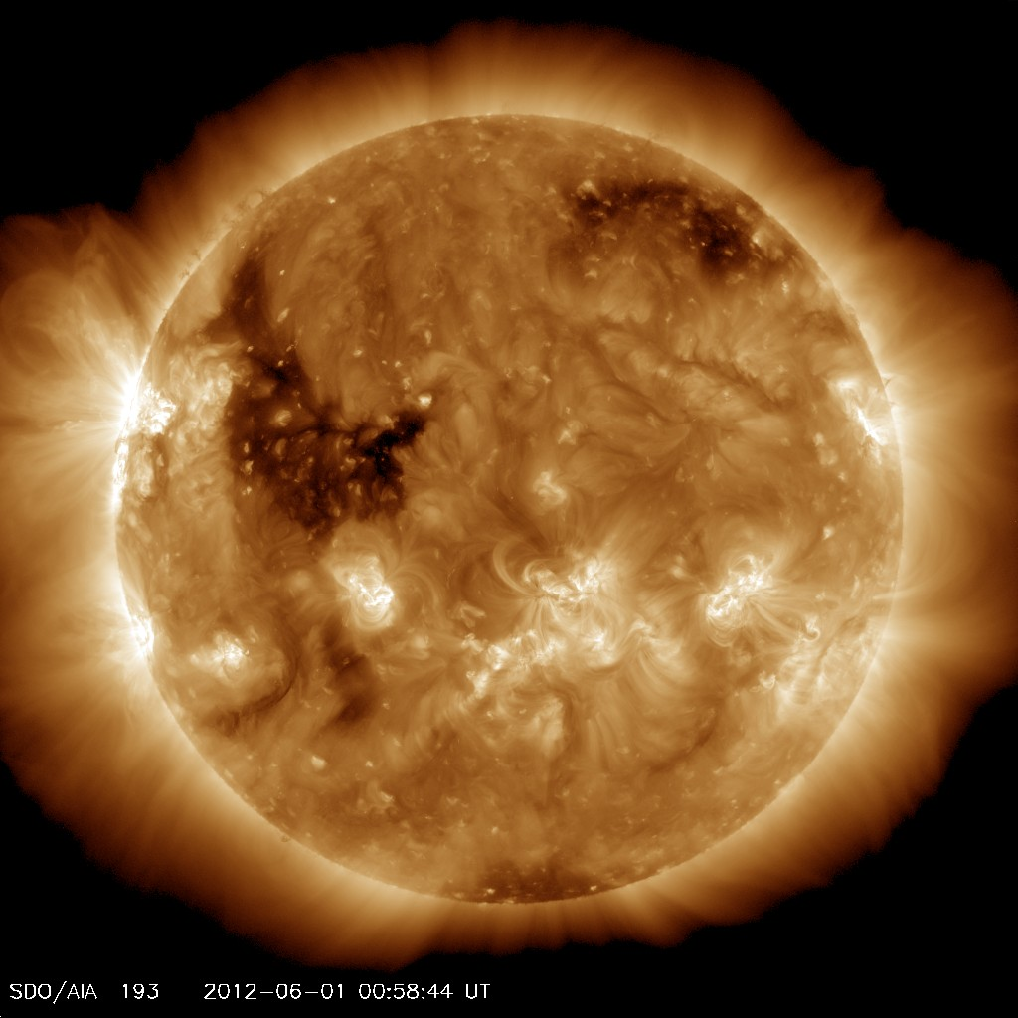
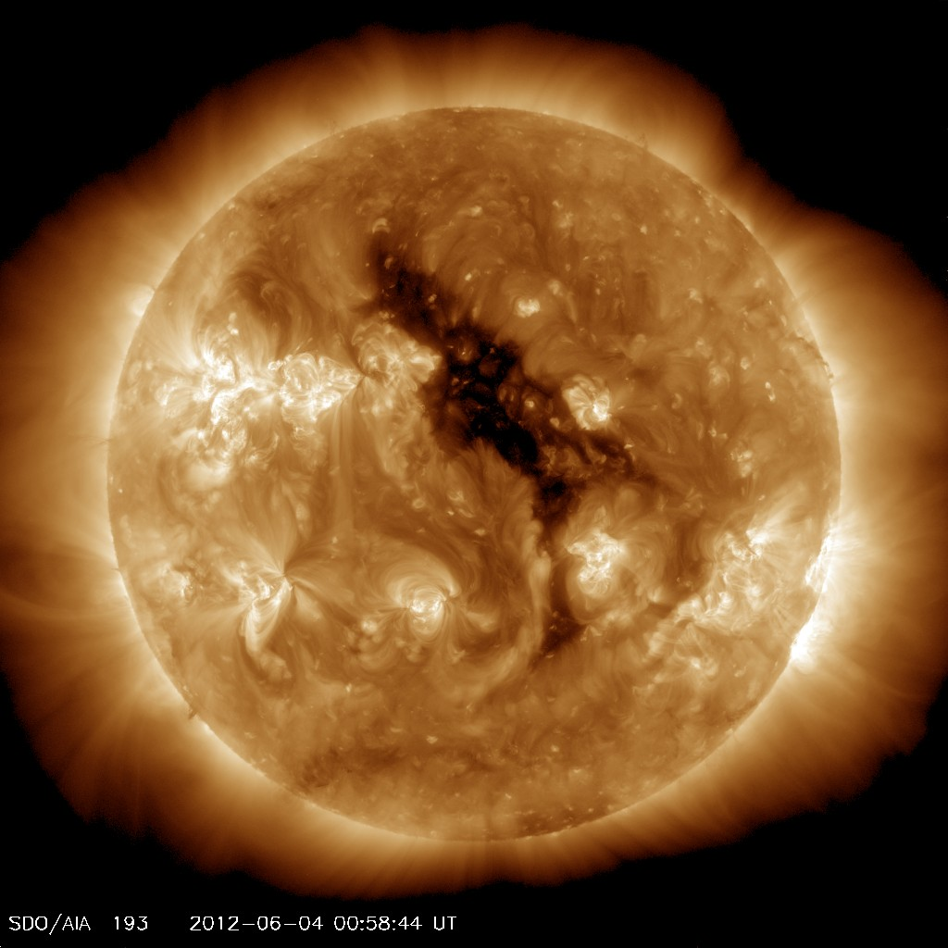

Slide 15
In-situ signatures of CME and CIR HSS at L1
ACE and WIND

Slide 16
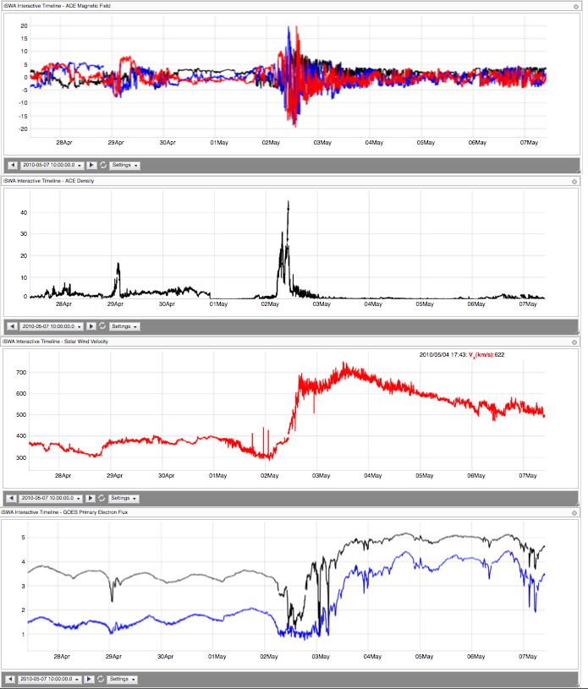
Clean HSS
May 2, 2010
Dense (20-30 cc), HSS
IMFBz: -18 nT
may be more hazardous to Earth-orbiting satellites than ICME-related magnetic storm particles and solar energetic particles
Electron radiation

Slide 17
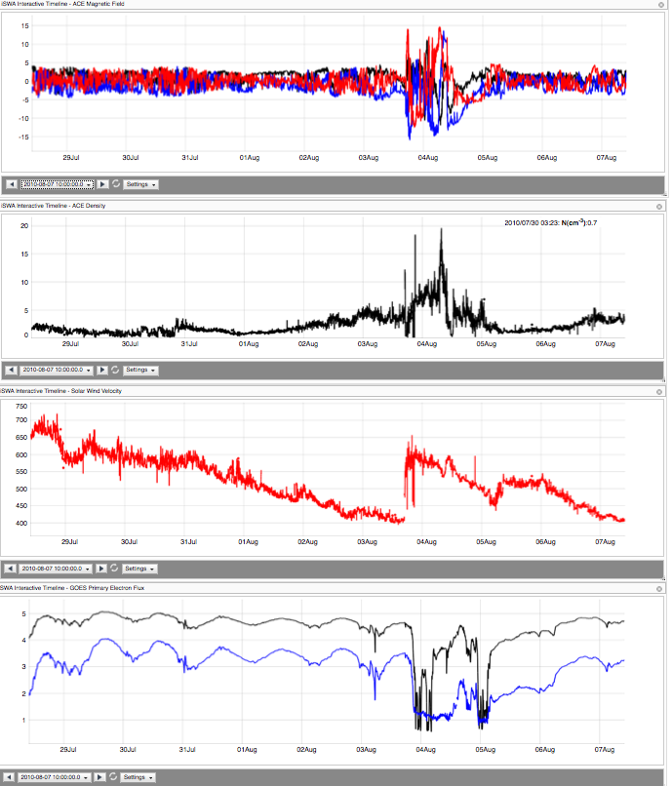
Aug 3, 2010

Slide 18
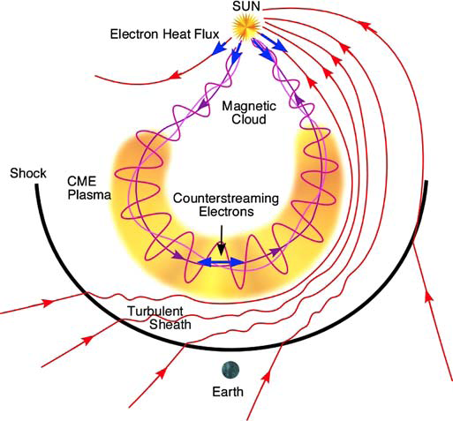
Schematic of the three-dimensional structure of an ICME and upstream shock

Slide 19
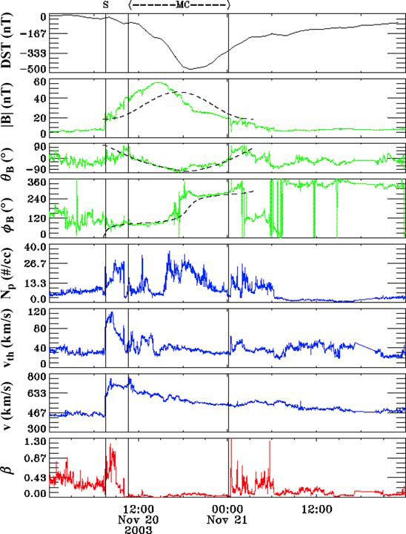
Textbook example of ICME in-situ signature
Gopalswamy, SSR, 2006
shock
sheath
Magnetic cloud
Notes:
Gopalswamy, N., PROPERTIES OF INTERPLANETARY CORONAL MASS EJECTIONS, Space Science Reviews (2006) 124: 145–168
A magnetic cloud is a transient ejection in the solar wind defined by relatively strong magnetic fields, a large and smooth rotation of the magnetic field direction over approximately 0.25AU at 1AU, and a low proton temperature [Burlaga et al., 1981]. Magnetic clouds are ideal objects for solar-terrestrial studies because of their simplicity and their extended intervals of southward and northward magnetic fields [Burlaga et al., 1990].

Slide 20
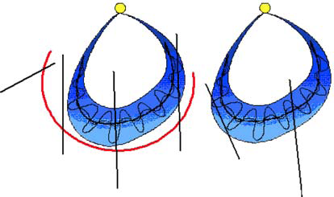
In-Situ signature can be quite complex
1: shock only
2: shock+sheath
5: ejecta?
4: ejecta?
3: shock+sheath+MC
6: MC only
Notes:
Six possible tracks of an observing spacecraft through an MC with a leading shock (left)
and another without (right). Tracks 1 and 2 never encounter the MC proper. They pass through the
shock and the compressed ambient medium in one of the flanks of the MC. Track 4 passes through
the nose of the MC. This situation arises when the observing spacecraft is along the Sun-Earth line
and a fast and wide CME erupts from close to the Sun center. Trajectory 4 passes through the shock,
sheath, and through the edge of the MC. Tracks 5 and 6 are similar to 4 and 3, respectively, except that
the MC is slow and hence it does not drive a shock. Trajectories 4 and 5 are not expected to observe
an MC structure.

Slide 21
Locating the CIR interface
increase of solar wind speed
pile-up of total perpendicular pressure (Pt) with gradual decreases at both sides from the Pt peak to the edges of the interaction region
velocity deflections
increase of proton number density
enhancement of proton temperature
increase of entropy,
compression of magnetic field.
Jian et al., 2006 Solar physics
McPherron et al., 2009, JASTP

Slide 22
Typical behavior of CIRs
east
west
Another example
394 stream interfaces in the interval 1995–2006
McPherron, R. L., D. N. Baker, and N. U. Crooker (2009), Role of the Russell-McPherron effect in the acceleration of relativistic electrons, J. Atmos. Sol. Terr. Phys., 71(10–11), 1032–1044

Slide 23
Both CME and CIRs are capable of generating geomagnetic storms. Differs in
Borovsky, J. E. and M. H. Denton ( 2006 ), Differences between CME‐driven storms and CIR‐driven storms , J. Geophys. Res. , 111 , A07S08, doi:10.1029/2005JA011447.
Notes:
Additional reading material – for those who are hungry for more.

Slide 24
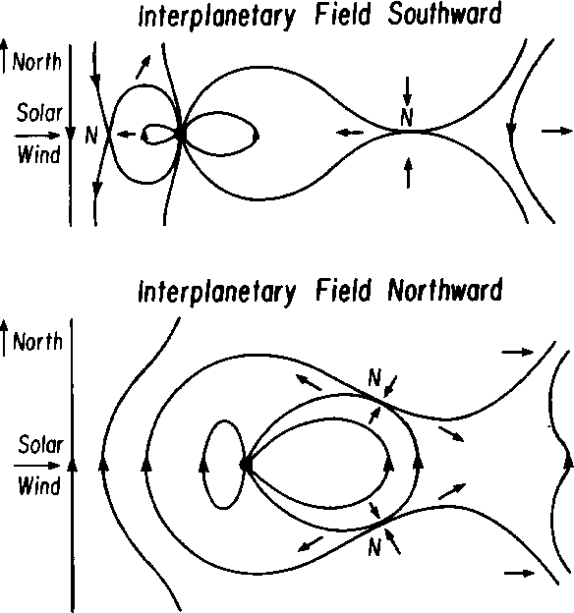
Two major types of solar wind-magnetosphere interactions
Southward IMF
Northward IMF
Notes:
Both CMEs and CIR/HSS can have these kind of IMF conditions

Slide 25
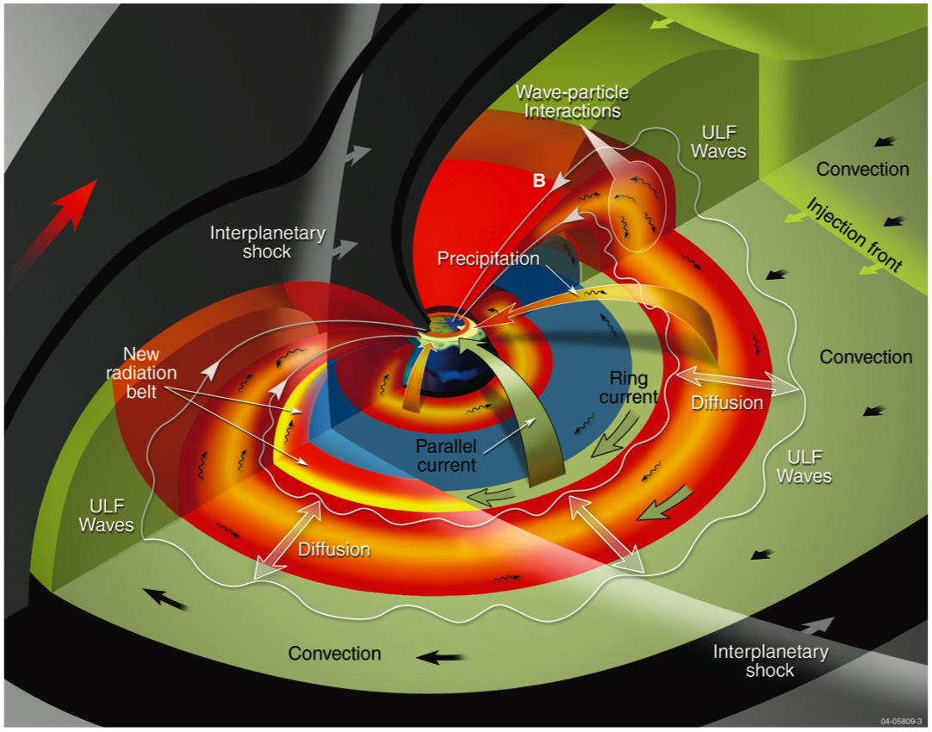
The Earth’s Magnetosphere
NASA

Slide 26
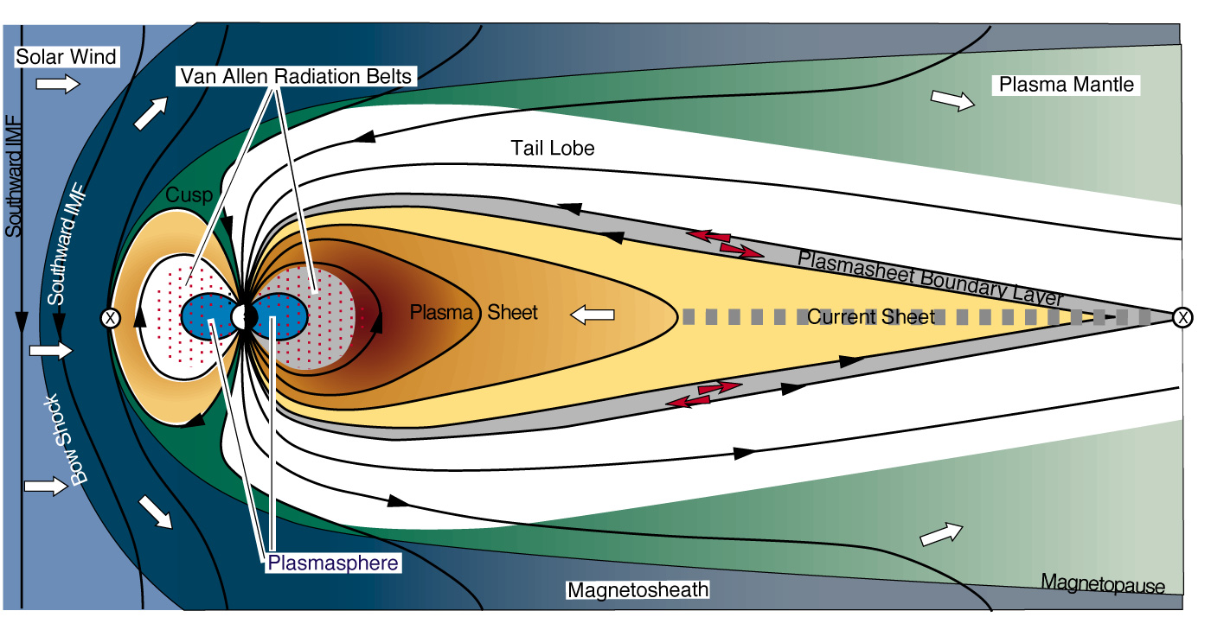
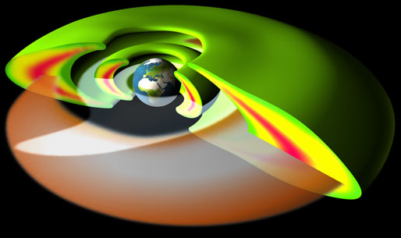
The Earth’s Magnetosphere
Inner Magnetosphere:
Up to ~ 10Re
Van Allen Belts
400 keV – 6 MeV
Plasmasphere
1-10 eV
Ring Current
1-400 keV
APL

Slide 27
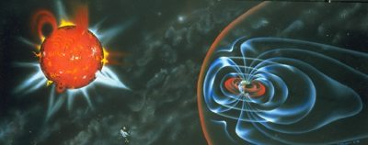
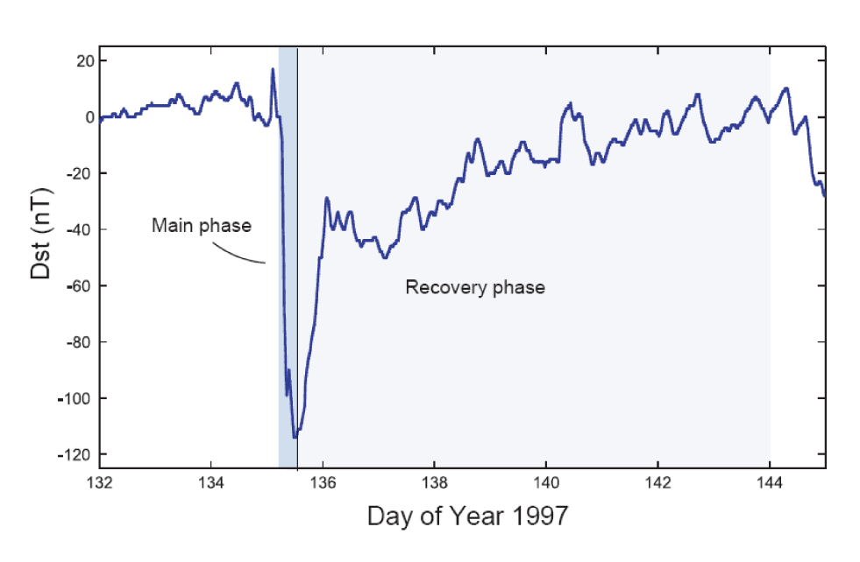
Magnetic Storms
Most intense solar wind-magnetosphere coupling
Associated with solar coronal mass ejections (CME), coronal holes HSS
IMF Bz southward, strong electric field in the tail
Formation of ring current and other global effects
Dst measures ring current development
Storm sudden commencement (SSC), main phase, and recovery phase
Duration: days

Slide 28
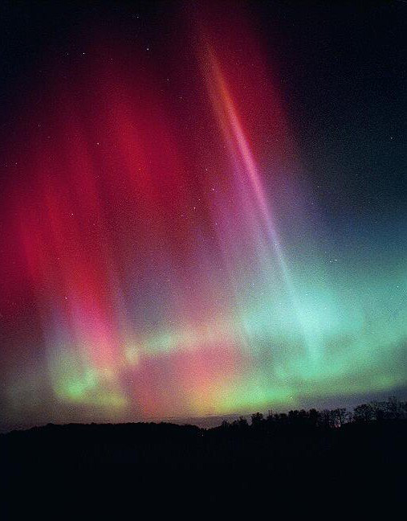
Substorms
Instabilities that abruptly and explosively release solar wind energy stored within the Earth’s magnetotail.
manifested most visually by a characteristic global development of auroras
Last ~ hours
Storms

Slide 29
Kp: measure of storm intensity
"planetarische Kennziffer" ( = planetary index).
Geomagnetic activity index
range from 0-9 disturbance levels of magnetic field on the ground - currents
Non-event - period of 12/01/2010 – 12/7/2010
Moderate event – April 5, 2010
Extreme event - Oct 29 – Oct 31, 2003
http://bit.ly/Kp_layout
Threshold Kp>=6

Slide 30
Geomagnetic Storm classification
http://www.swpc.noaa.gov/NOAAscales/index.html#GeomagneticStorms
Operational world

Slide 31
Dst: Disturbance of Storm Time
Measure of Storm Intensity
CIR storm
CME storm
CIR storm at most: Dstmin ~ -130 nT
CME storm: Dstmin ~ -600 nT
1989 March 14 Dstmin= -589 nT
Notes:
Weak stormMinimum Dst below -30 nT
Moderate stormMinimum Dst below -50 nT
Strong stormMinimum Dst below -100 nT
Severe stormMinimum Dst below -200 nT
Great stormMinimum Dst below -350 nT
The size of a geomagnetic storm is classified as moderate (-50 nT > minimum of Dst < -100 nT), intense (-100 nT > minimum Dst < -250 nT) or super-storm ( minimum of Dst > -250 nT.

Slide 32
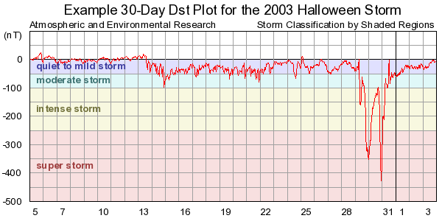
Geomagnetic Storm Classification Research
Notes:
CIR only results in a storm at most – intense
CME can sometimes result in a superstorm

Slide 33
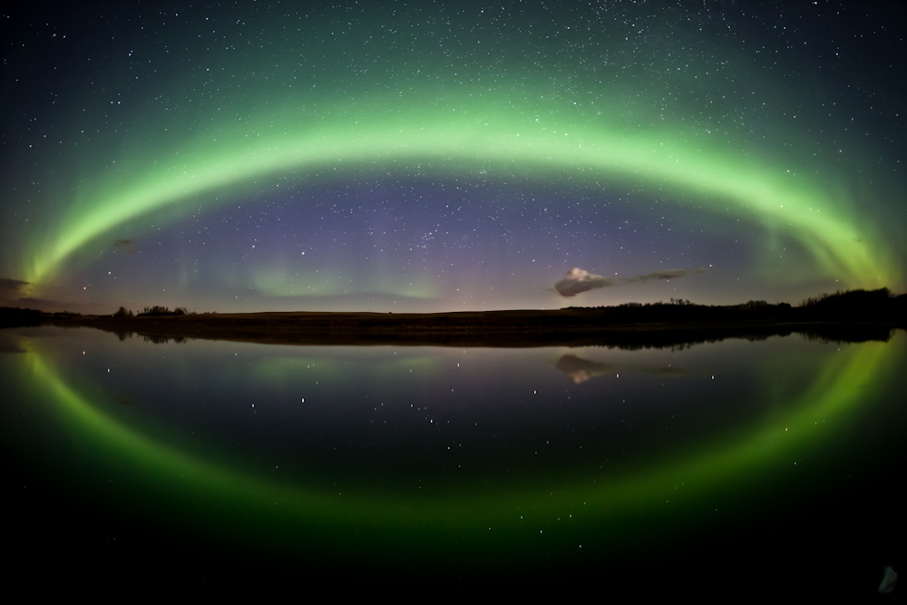
Notes:
Does not take too much geomagnetic activity to see aurora at high-latitudes

Slide 34
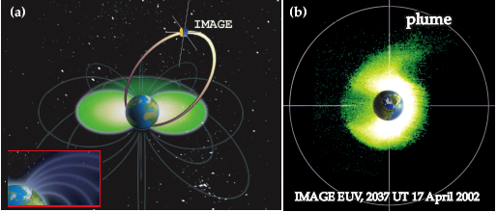
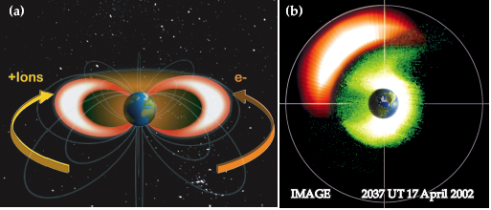
Inner magnetosphere plasmas
Plasmasphere
1-10 eV ions
ionospheric origin
Ring current
1-400 keV ions
both ionospheric and solar wind origin
Outer radiation belt
0.4-10 MeV electrons
magnetospheric origin
(Goldstein et al.)
(Goldstein et al.)
Inner magnetosphere: Gigantic Particle accelerator
(Reeves et al.)

Slide 35
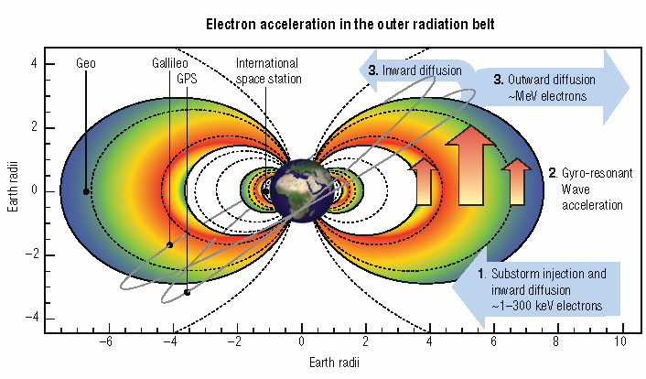
RB: Current understanding
Horne et al., 2007, Nature Physics

Slide 36
Various types of waves that are important to RB dynamics

Slide 37
Van Allen Probes: current mission on radiation belt dynamics
Courtesy: Baker et al.

Slide 38
Three-Belt Structure
Quiet-time phenomenon

Slide 39
Different impacts on RB CME vs CIR storms
CME geomagnetic storms: RB flux peak inside geosynchronous orbit. The peak locations moves inward as storm intensity increases
CIR geomagnetic storms: More responsible for the electron radiation level enhancement at GEO orbit

Slide 40
HSS and radiation belt electron flux enhancement
GOES data of energetic electron fluxes
ACE measurements of Solar Wind Speed
Notes:
CIR geomagnetic storms – more responsible for the radiation level enhancement at/near GEO orbit

Slide 41
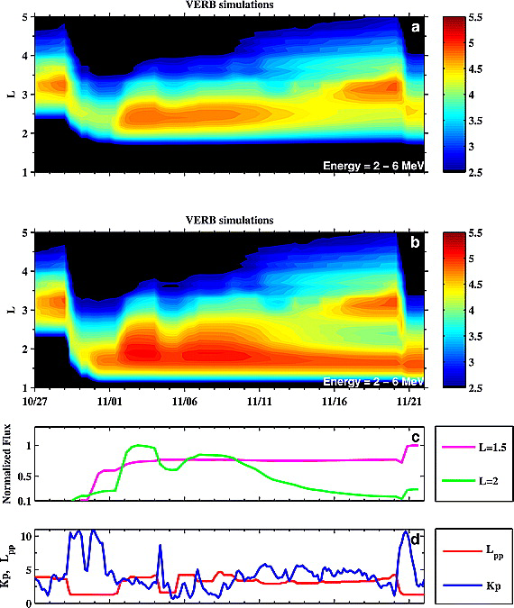
CME (superstorm condition) impact on RB
Halloween storm
Carrington-like superstorm
Notes:
CMEstorm: RB flux peaks more inward than peak of those CIR storms
Shprits et al., 2011, Space Weather

Slide 42
CME (superstorm condition) impact on RB
Shprits et al., 2011, Space Weather

Slide 43
SWx consequences of CIR HSS
CIR HSS: usually long-duration (3-4 days)
Radiation belt electron flux enhancement
Surface charging
Geomagnetic disturbances (moderate at most)
heating of upper atmosphere: satellite drag
Energetic electron radiation: ( the >0.8 MeV electron flux exceeding 10^5 pfu alert threshold): takes 2-3 days from the CIR interface
Although geomagnetic activity (due to CIR HSS) during the declining and
minimum phases of the solar cycle appears to be relatively benign (especially in comparison to the dramatic and very intense magnetic storms caused by interplanetary coronal mass ejections (ICMEs) that predominate during solar maximum), this is misleading. Research has shown that the time-averaged, accumulated energy input into the magnetosphere and ionosphere due to high speed streams can be greater during these solar phases than due to ICMEs during solar maximum!

Slide 44
Homework
March 1, 2011 high speed streams, find out the time of arrival and examine its behavior in terms of speed and density profile, IMF characteristics, when the >0.8 MeV energetic electron flux at GOES started to exceed 10^5 pfu?
Do the same for the June 4, 2012 HSS
You can do the homework using this iSWA layout for HSS
http://bit.ly/HSS_layout_20110301

Slide 45
Homework
Find all Kp >=6 times for the year 2013
(Challenging one -optional: and the potential cause of Kp>=6 – CME, CIR HSS or combination, or others)
Has the magnetopause stand-off distance been smaller than 6.6 Re (Re: Earth radii), i.e., magnetopause been pushed inside geosynchronous orbit? when? (year 2013)
The periods when GOES >0.8 MeV electron flux exceeding 10^5 pfu (year 2013)
Iswa layout for homework
http://1.usa.gov/191s6AU

Slide 46
Homework on SEP radiation storms
1. Find when GOES > 10 MeV proton flux exceeding 10 pfu in 2013
Those who like challenges
2. Find when 13-100 MeV proton flux at STEREO A exceeding 0.1pfu/MeV in 2013
3. Do the same for STEREO B
Iswa layout to help you with the homework questions
http://1.usa.gov/15Eov7s

Slide 47
magnetospsheric products

Slide 48
Kp
"planetarische Kennziffer" ( = planetary index).
Geomagnetic activity index
range from 0-9 disturbance levels of magnetic field on the ground - currents
Non-event - period of 12/01/2010 – 12/7/2010
Moderate event – April 5, 2010
Extreme event - Oct 29 – Oct 31, 2003
http://bit.ly/Kp_layout
Threshold Kp>=6

Slide 49
HSS and RBE flux enhancement

Slide 50
Magnetopause stand-off distance delineating the boundary between SW and Earth’s magnetosphere
r0 <=6.6 Re – model product
Events: Dec 28, 2010
Jan 7,2010 kp=5 at 22:30 UT on 1/6/2011
Non-event: Dec 1 – 7, 2010
Degree of compression of MP
Due to Pdyn of solar wind
(interplanetary shock /HSS)

Slide 51
An iSWA layout for magnetospheric products
http://bit.ly/iswa_mag

