Slide 1


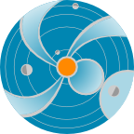
Earth’s Magnetosphere
Space
Weather
Research
Center
CCMC/SWRC SW REDI
NASA Goddard Space Flight Center
Notes:
In this presentation I will be talking about the Sun and its activity in relations to the space weather
(http://iswa3.ccmc.gsfc.nasa.gov/wiki/index.php/Glossary/_space_weather)

Slide 2
Magnetic Field of the Earth
The Earth's magnetic field is similar to that of a bar magnet.
The magnitude varies over the surface of the Earth in the range 0.3 to 0.6 Gauss.
Notes:
The Earth's magnetic field is similar to that of a bar magnet tilted 11 degrees from the spin axis of the Earth.
The magnitude of the magnetic field varies over the surface of the Earth in the range 0.3 to 0.6 Gauss.

Slide 3
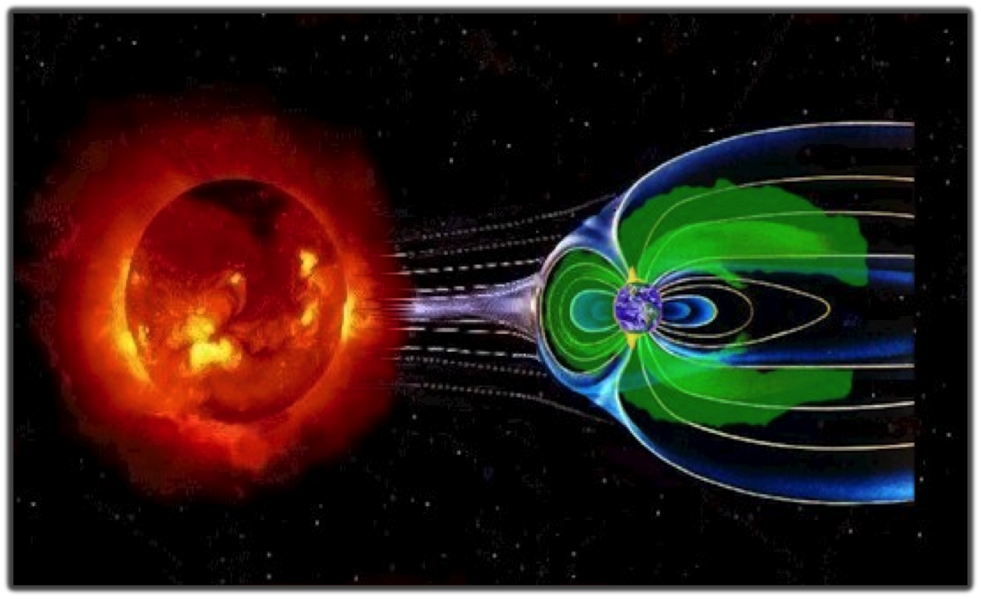
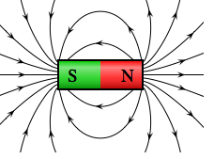
Earth’s Magnetic Field – Our Shield
(not to scale)
Magnetosphere
Magnetopause Sub-solar point
Earth
The solar wind pushes and stretches Earth’s magnetic field into comet-shaped region called the magnetosphere. The magnetosphere and Earth’s atmosphere protect us from the solar wind and other kinds of solar and cosmic radiation.
Notes:
The solar wind pushes and stretches Earth’s magnetic field into a vast, comet-shaped region called the magnetosphere. The magnetosphere and Earth’s atmosphere protect us from the solar wind and other kinds of solar and cosmic radiation.
Solar wind – Earth’s magnetic field field interaction flatten the nose (dayside – towards the sun) and drag field lines to the tail (night-side – away from the sun).
The magnetopause separates Earth's magnetic domain from the solar wind and its embedded interplanetary field (IMF).
The three-dimensional location of the magnetopause represents a balance of pressures: Pressures of solar-origin (predominantly solar wind flow ram pressure) balance pressures of Earth-origin (predominantly outward magnetic pressure) at the magnetopause.
The magnetic field is the shield that protects the Earth from the solar plasma particles because they have difficulty in moving across the magnetic field lines.
If the Earth did not have the magnetic field, continuously blowing solar wind and CMEs would most likely wipe out all the life forms on the Earth. Scientists speculate that something like this could have happened on Mars, who lost its magnetic field over the time.
The Sun-Earth line cross the magnetopause at the Sub-solar point. Magnetopause stand-off distance is the distance to the magnetopause sub-solar point.
Under quiet conditions the magnetopause sub-solar point is about 10 to 12 Earth’s radii away from Earth.
1 R_{E} (Earth’s radius) = 6370 km
In dense solar wind or in the presence of a strong and negative solar wind magnetic field component B_{z}, the magnetopause can move closer and even cross geosynchronous orbit (distance about 6.7 R_{E}).

Slide 4
Spatial Scales
Magnetosphere
Earth
1 R_{E} (Earth’s radius) = 6370 km
1 R_{S} (Solar radius) ~ 110 R_{E}
1 AU (Distance between the Sun and the Earth ) ~ 215 R_{S}
Notes:
Distances in Solar Corona are expressed in Solar radii: 1 – 20 R_{S}
Solar radius is approximately 100 times larger than the Earth’s radius.
Distances in magnetosphere are expressed in Earth radii.
During quit solar wind conditions the sub-solar point of the magnetosphere boundary is at about 10 R_{E} from the Earth.
The tail width is about 30-40 R_{E,.}The tail length is 1000s R_{E}
The distance to the moon is about 60 R_{E,}

Slide 5
Watch the video
Mysteries of the Sun
http://www.nasa.gov/mission_pages/sunearth/news/mystery-sun.html
Notes:
The Earth's magnetic field is similar to that of a bar magnet tilted 11 degrees from the spin axis of the Earth.
The magnitude of the magnetic varies over the surface of the Earth in the range 0.3 to 0.6 Gauss.

Slide 6
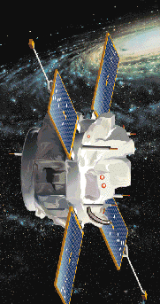
Lagrangian Point – L1
Advanced
Composition
Explorer
L1 (Solar Wind Monitor ACE location): ~ 200 R_{E} sunward
You can fit 1 Sun between the Earth and L1.
2 R_{S} (Solar diameter) ~ 220 R_{E}
Notes:
The Lagrangian points (/L-points) are the five positions in an orbital configuration where a spacecraft affected only by gravity can
maintain its position relative to the two massive bodies (the Earth and the Sun).
You can almost fit 1 solar diameter (~ 200 R_{E} ) between the Earth and L1.
Solar wind monitor ACE is positioned at L1 point.
It takes about 30 – 60 min (depending on the speed of the solar wind) for the disturbance observed at L1 to reach the Earth.

Slide 7
Solar Wind Speed at ACE

Slide 8
Solar Wind Parameters at ACE
on 04/05/2010
Magnetic field
B_{x}, B_{y,} B_{z}
nT
X: Earth to Sun
Z: South to North
km/s
Velocity
Density
part/cm³
Notes:
1 nT = 10 ⁻⁵ Gauss

Slide 9
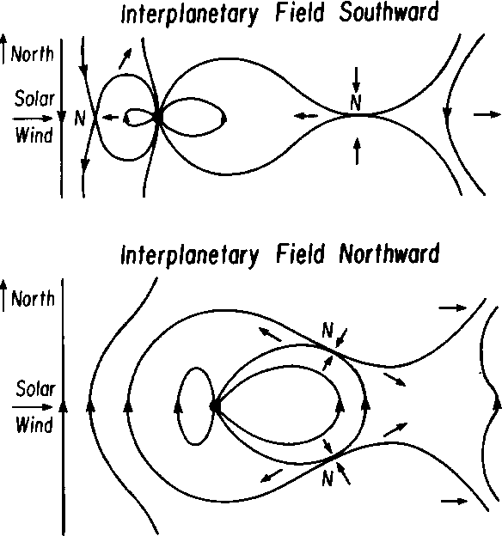
Magnetosphere for Southward and Northward IMF Orientation

Slide 10
Magnetosphere:
Northward IMF
X: Earth to Sun
Z: South to North
Z
X
Sun
Red lines (closed): Magnetic field (MF) lines with both ends connected to the Earth
Black lines (open): MF lines with only one end a the Earth
Blue lines (interplanetary): MF lines with both ends in the interplanetary space

Slide 11
Magnetosphere:
Southward IMF
Red lines (closed): Magnetic field (MF) lines with both ends connected to the Earth
Black lines (open): MF lines with only one end a the Earth
Blue lines (interplanetary): MF lines with both ends in the interplanetary space

Slide 12
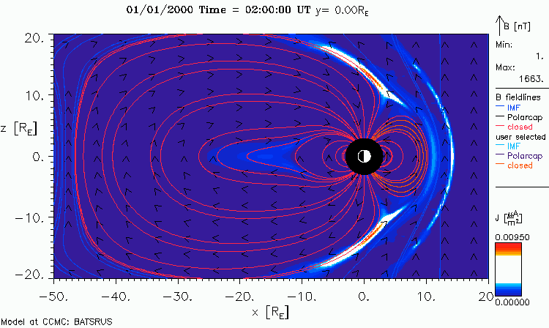
Magnetosphere:
North to South Turning

Slide 13
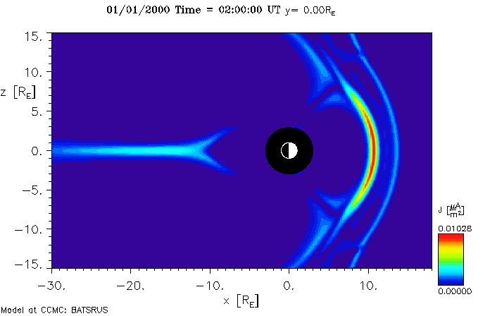
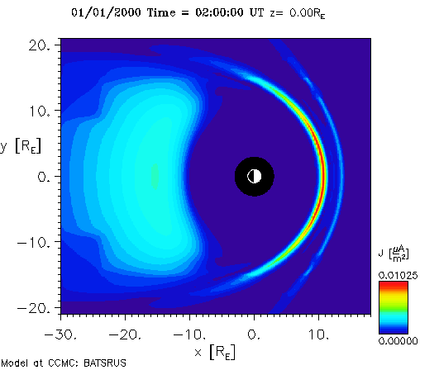
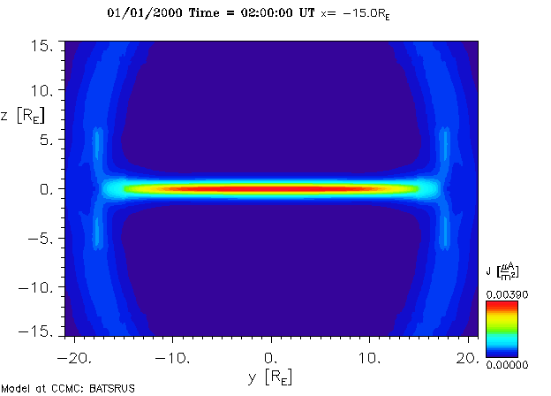
Magnetosphere
in Different Cut Planes
meridional cut Y=0
Bow shock
equatorial cut Z=0
Bow shock
Magnetotail
Magnetopause
Magnetotail current sheet
cross-tail cut X= -15 R_{E}

Slide 14
Magnetosphere:
Quiet vs. Compressed
Geosynch. orbit
Magnetopause

Slide 15
Magnetopause Stand-off Distance
Degree of compression of MP
Due to Pdyn of solar wind
(interplanetary shock or HSS)
r0 <=6.6 Re – model product
Events: Apr 5, 2010,
Dec 28, 2010
Jan 6, 2011, 22:30 UT
Non-event: Dec 1 – 7, 2010

Slide 16
Kp
"planetarische Kennziffer" ( = planetary index).
Geomagnetic activity index
range from 0-9 disturbance levels of magnetic field on the ground - currents
Non-event - period of 12/01/2010 – 12/7/2010
Moderate event – April 5, 2010
Extreme event - Oct 29 – Oct 31, 2003
http://bit.ly/Kp_layout
Threshold Kp>=6
Notes:
The Kp index indicates the magnitude of geomagnetic disturbance on a 0-9 scale, with zero being very quiet and 9 indicating a major geomagnetic storm. The index has a three-hour cadence. Higher values of Kp are associated with geomagnetic storming

Slide 17
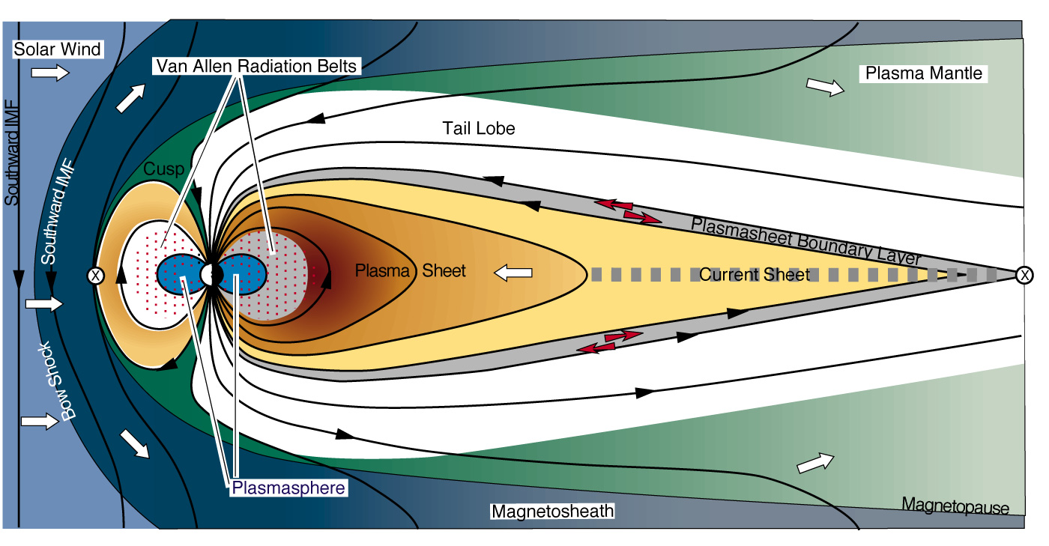
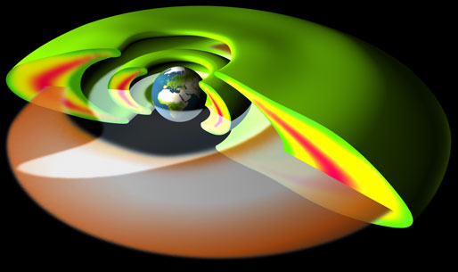
Inner Magnetosphere
(up to ~ 10 RE)
Van Allen Belts
400 keV – 6 MeV
Plasmasphere
1-10 eV
Ring Current
1-400 keV
APL
Notes:
1 nT = 10 ⁻⁵ Gauss

Slide 18
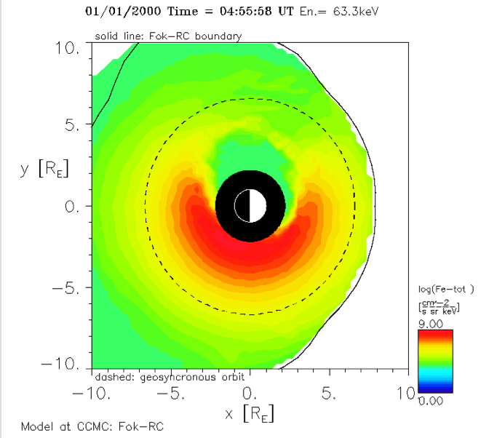
Electron Total Flux.
Energy 63.3 keV. Color Contour
Equatorial Plane
Magnetopause
Geosynch. Orbit
Sun
Earth radius

Slide 19
Ring Current:
Quiet vs. Active

Slide 20
HSS and Radiation Belt
Electron Flux Enhancement

Slide 21
Energetic Proton Flux
>10 MeV flux by GOES spacecraft
Threshold: 10 pfu
  Non –event Dec 1 – 7, 2010
  Event: Aug 14 – 18, 2010

Slide 22
iSWA Layout:
04/05/2010
http://iswa.gsfc.nasa.gov/IswaSystemWebApp/index.jsp?i_1=327&l_1=9&t_1=2130&w_1=1372&h_1=403&s_1=2010-04-07%2000:00:00.0!3!&i_2=335&l_2=32&t_2=300&w_2=800&h_2=400&s_2=2010-04-06%2022:30:00.0!3!&i_3=41&l_3=878&t_3=734&w_3=495&h_3=416&s_3=2010-04-05%2010:00:00.0_0_10_3&i_4=51&l_4=858&t_4=1209&w_4=509&h_4=477&s_4=2010-04-05%2010:00:00.0_1_80_3&i_5=337&l_5=836&t_5=300&w_5=800&h_5=400&s_5=2010-04-07%2000:00:00.0!3!&i_6=323&l_6=8&t_6=2552&w_6=1370&h_6=390&s_6=2010-04-07%2000:00:00.0!3!&i_7=325&l_7=6&t_7=1700&w_7=1380&h_7=408&s_7=2010-04-07%2000:00:00.0!3!&i_8=125&l_8=390&t_8=2965&w_8=646&h_8=418&s_8=2010-04-06%2023:56:00.0_0_10_3&i_9=39&l_9=175&t_9=1226&w_9=493&h_9=409&s_9=2010-04-05%2010:00:00.0_0_10_3&i_10=43&l_10=33&t_10=722&w_10=792&h_10=468&s_10=2010-04-05%2010:00:00.0_0_10_3

